Slide 1
Urban agriculture in Indian cities
Sustainability, need and associated challenges
Vishal Shaukeen

Slide 2
Agenda
Urban agriculture at global level
India: Post-colonial era
Impact of globalisation and technology
Recent trends in India
Chemical free movement
Challenges and Future Scope
A day at a farm

Slide 3
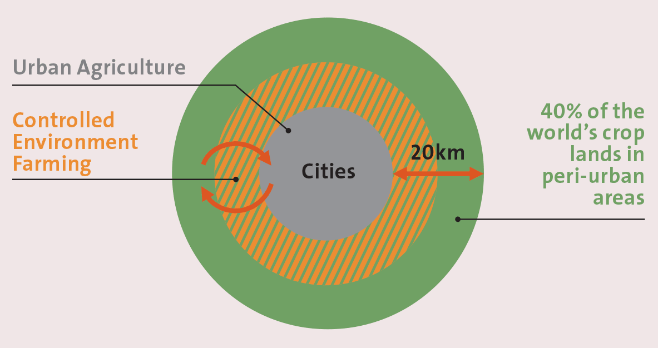
Urban agriculture at global level

Slide 4
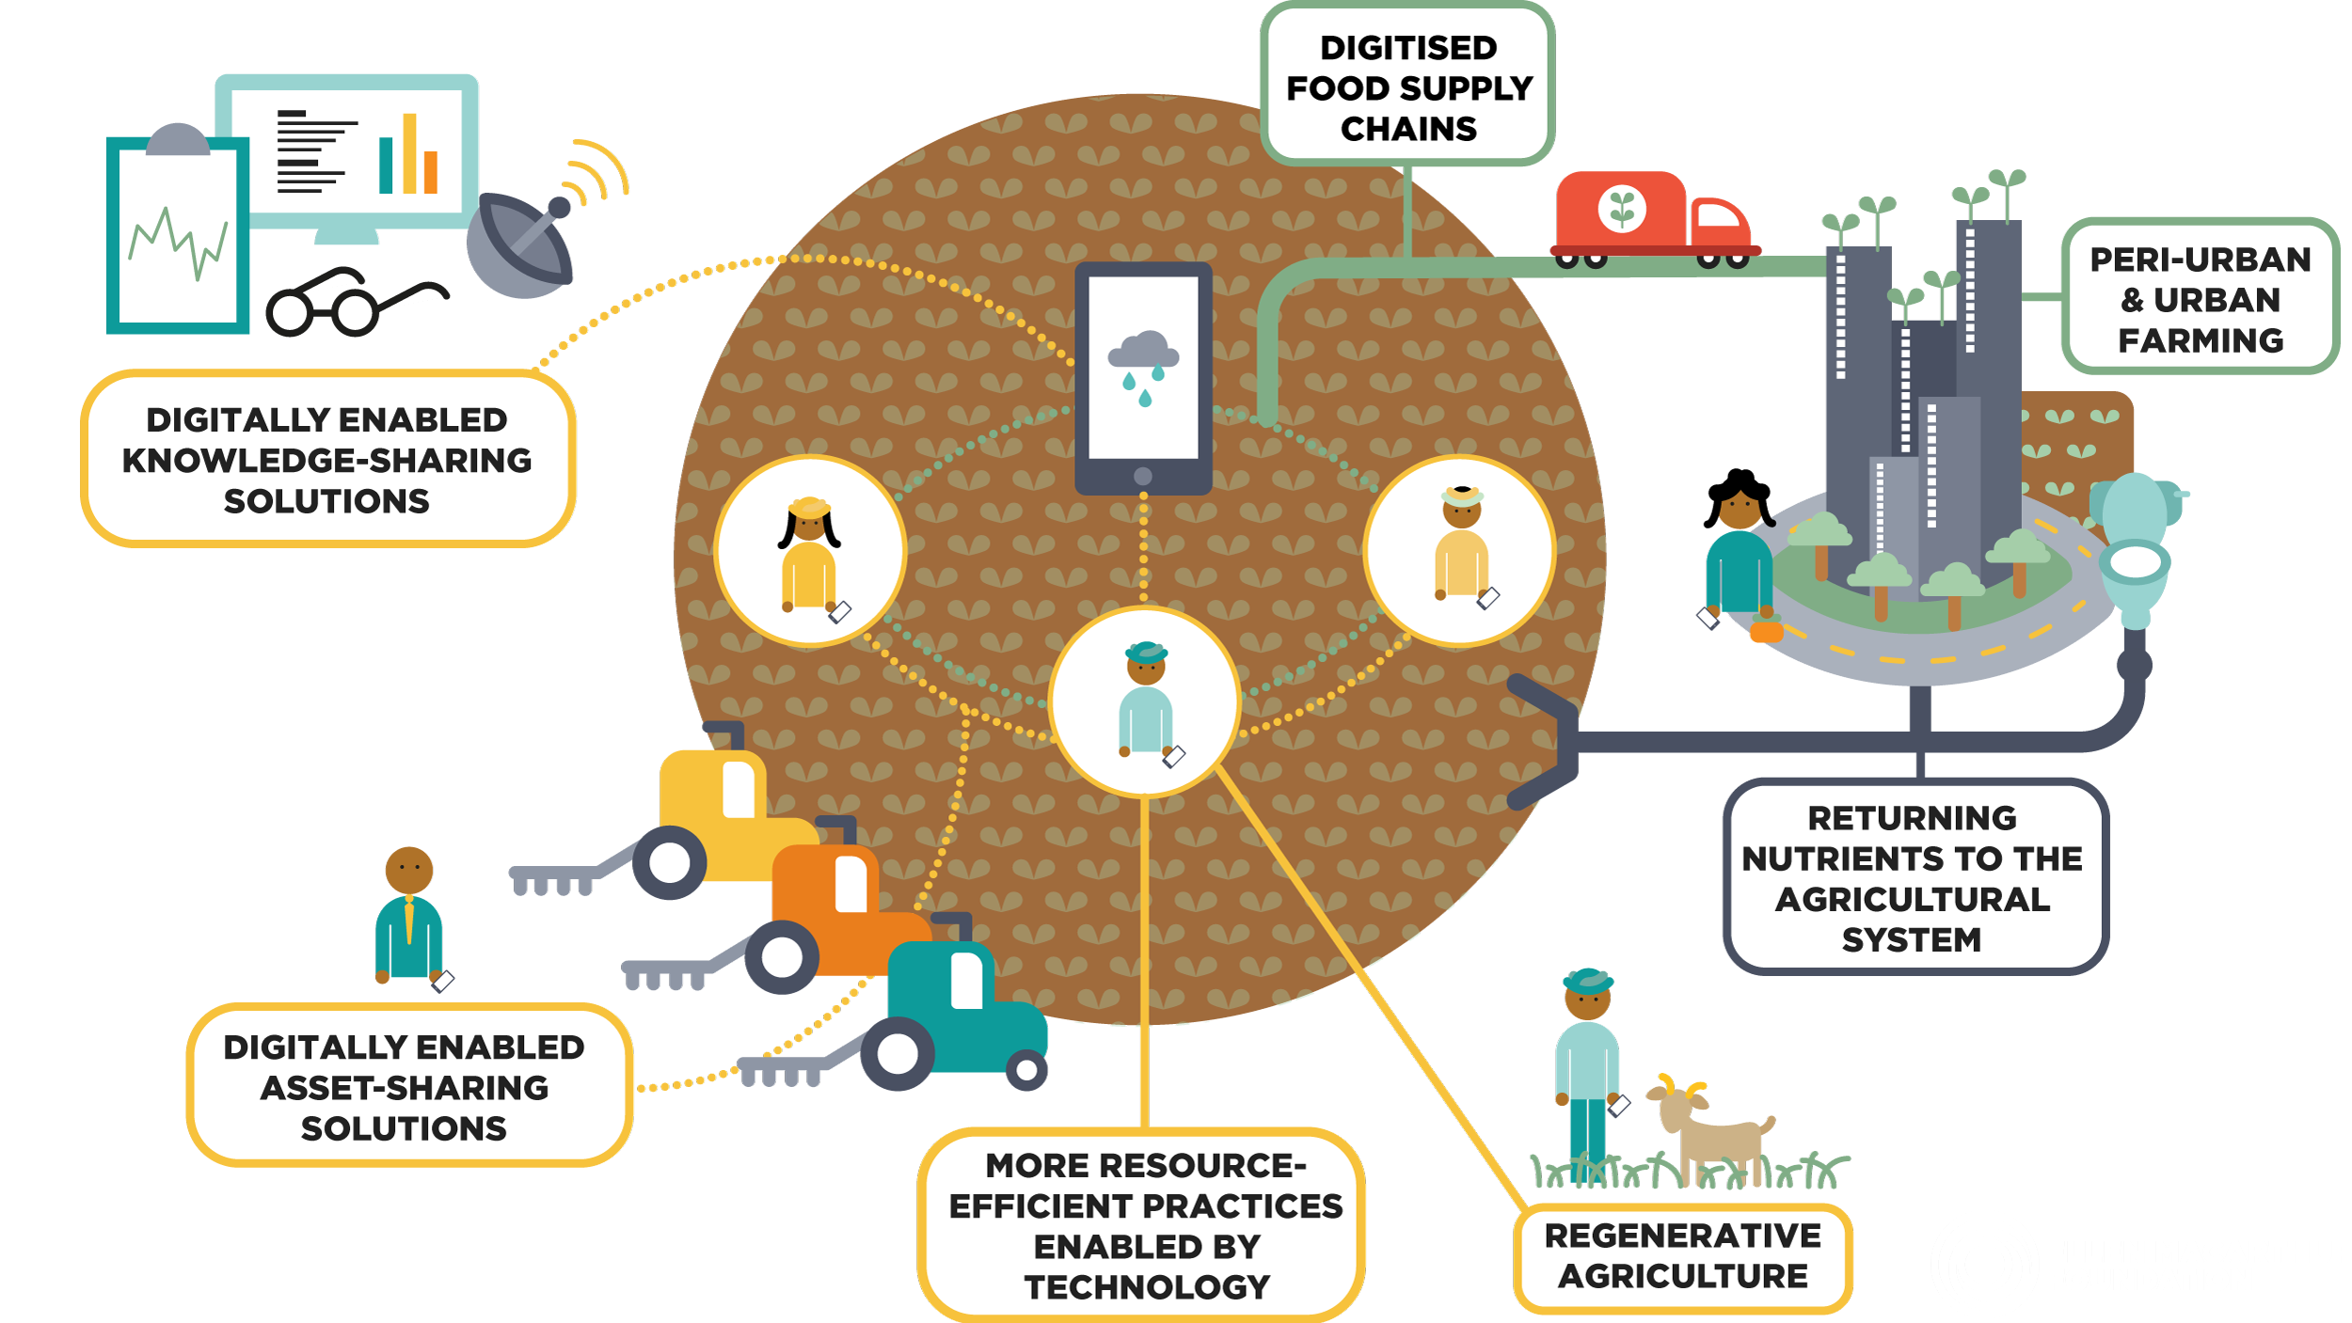

Slide 5
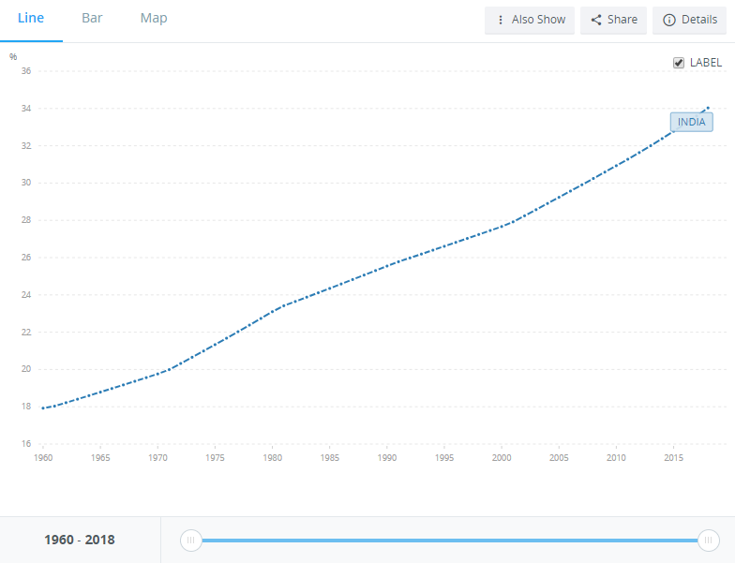
India: Post-colonial era
Change in concentration of urban population

Slide 6
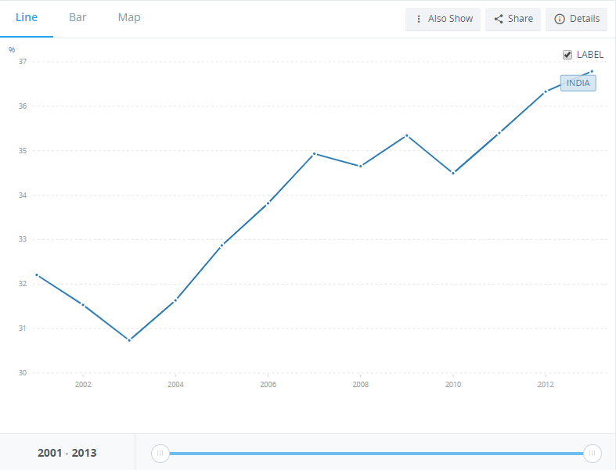
Agricultural irrigated land (% of total agricultural land)

Slide 7
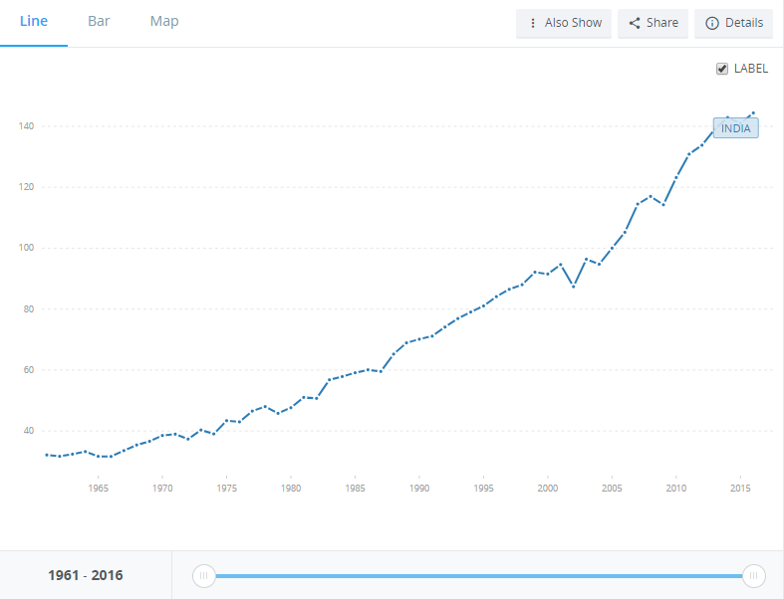
Food production in India

Slide 8
Impact of globalisation and technology
Consumption of exotic vegetables in hospitality sector

Slide 9
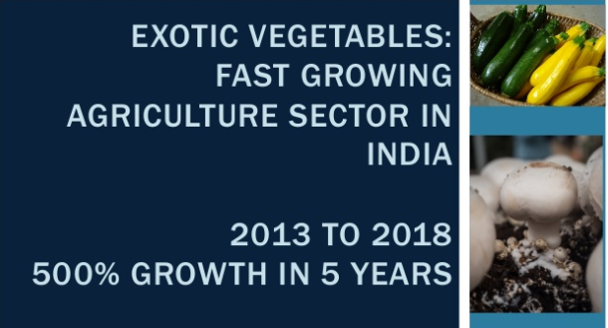

Slide 10
Recent trends in India
Rooftop gardens
Kitchen gardens
Collaborative farming
E-commerce and digital connectivity
Farmers’ markets

Slide 11

Chemical free movement

Slide 12
Challenges and Future Scope
Challenges:
Land use change
Labour availability
Governmental policies
Cost of production
Waste management
Scaling up
Crop variety
The way ahead:
Awareness
Planning and directional growth
Synergetic development
‘Food theatres’
Inclusive growth
‘Labour use, not abuse’

Slide 13

A day at a farm

Slide 14
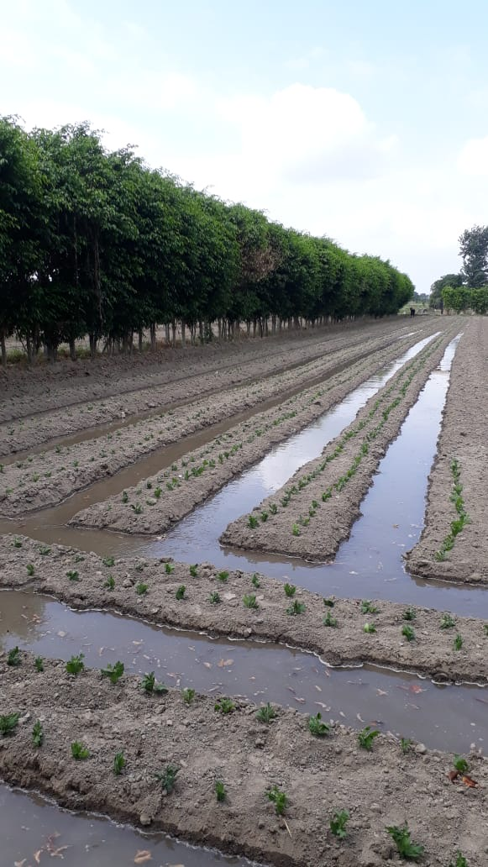
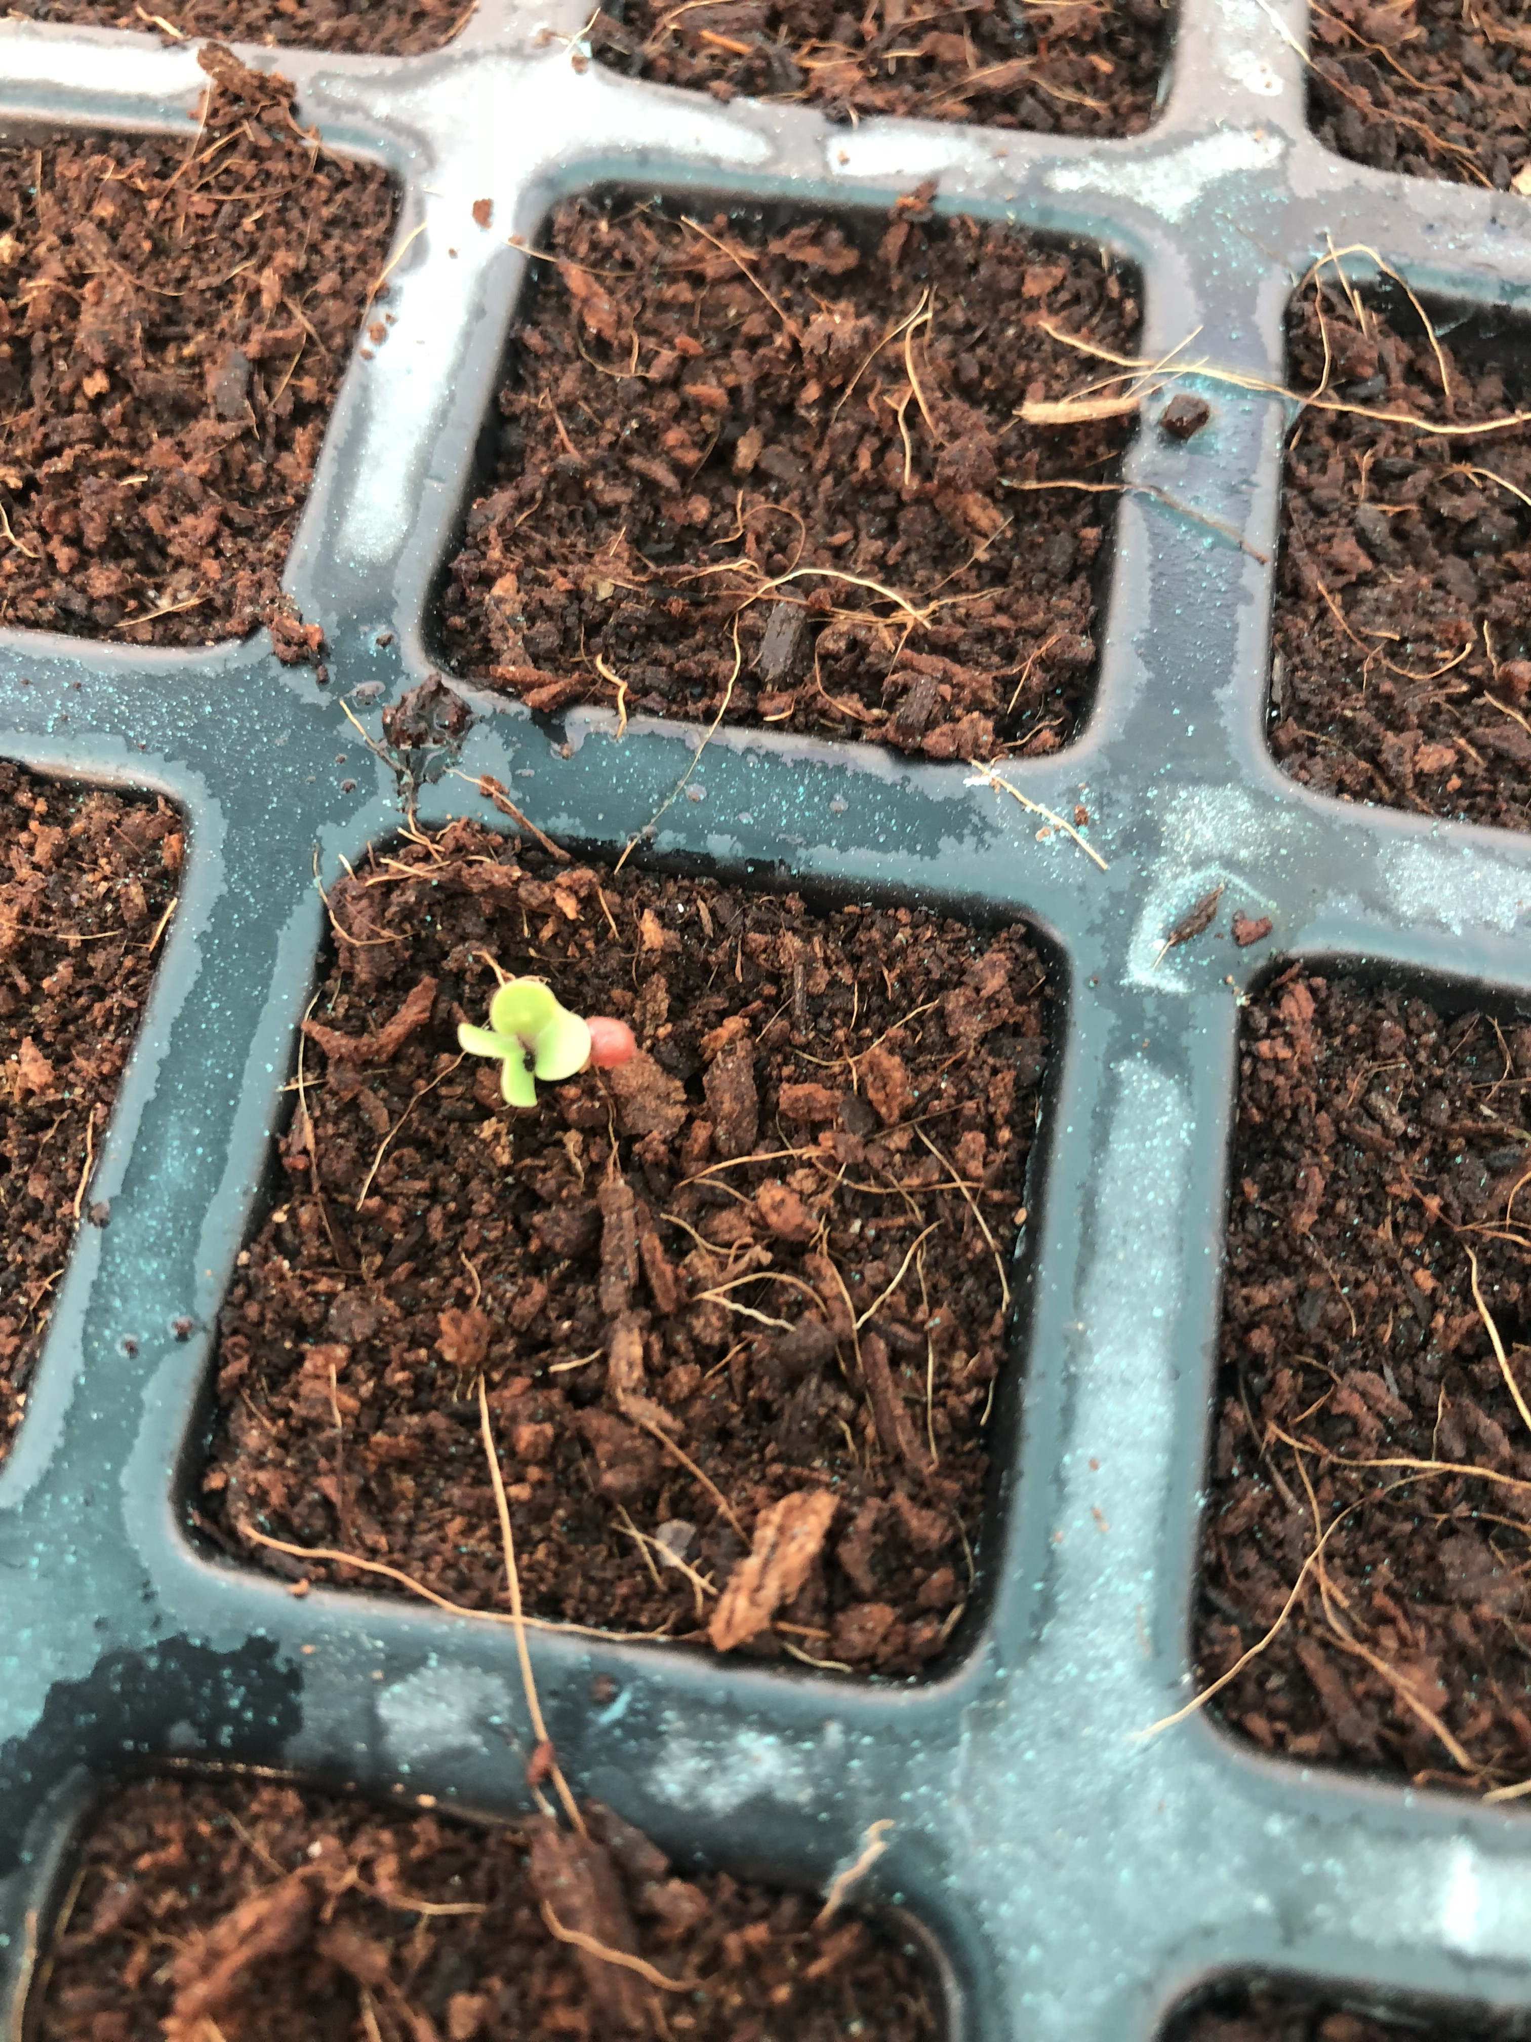

Slide 15
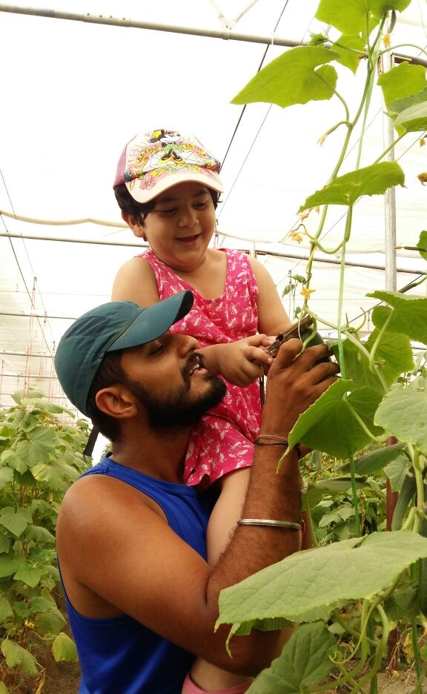
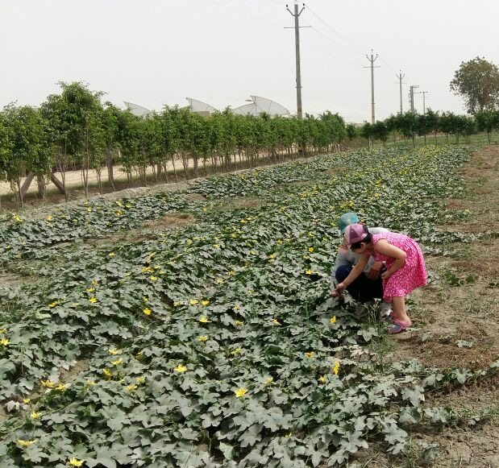

Slide 16
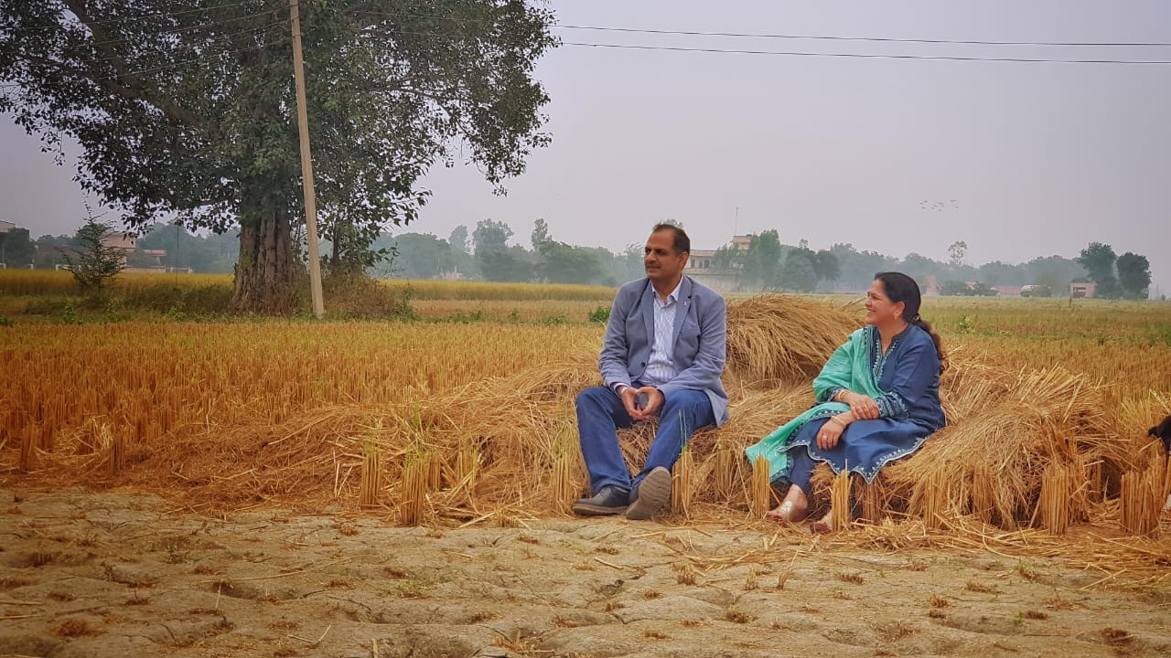

Slide 17
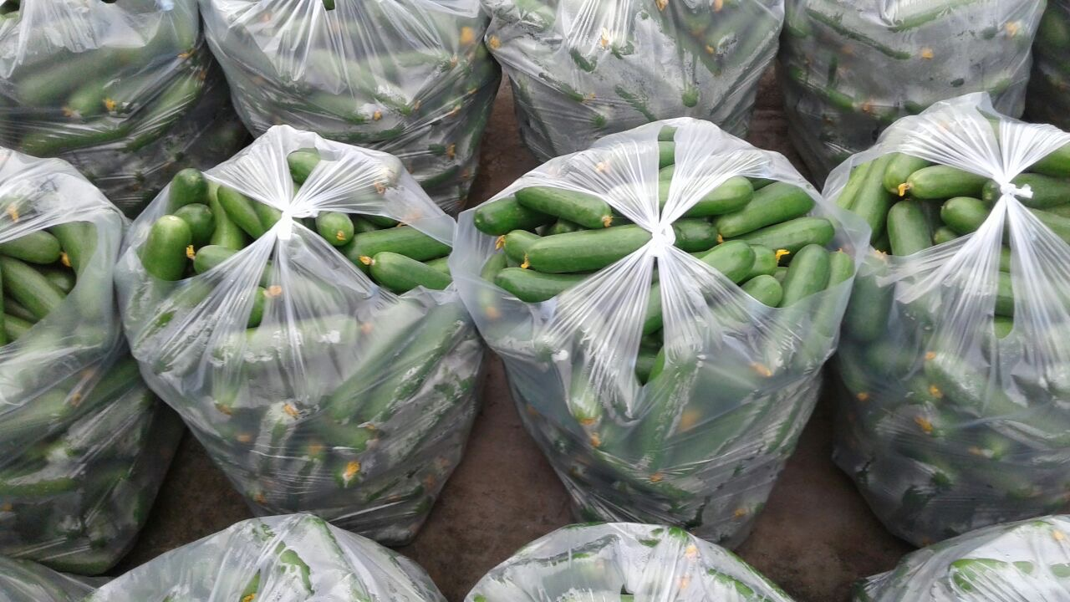

Slide 18
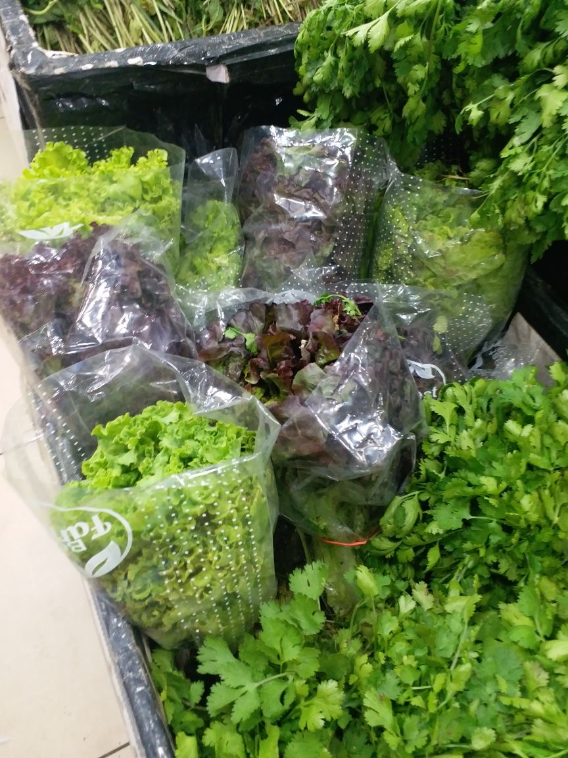
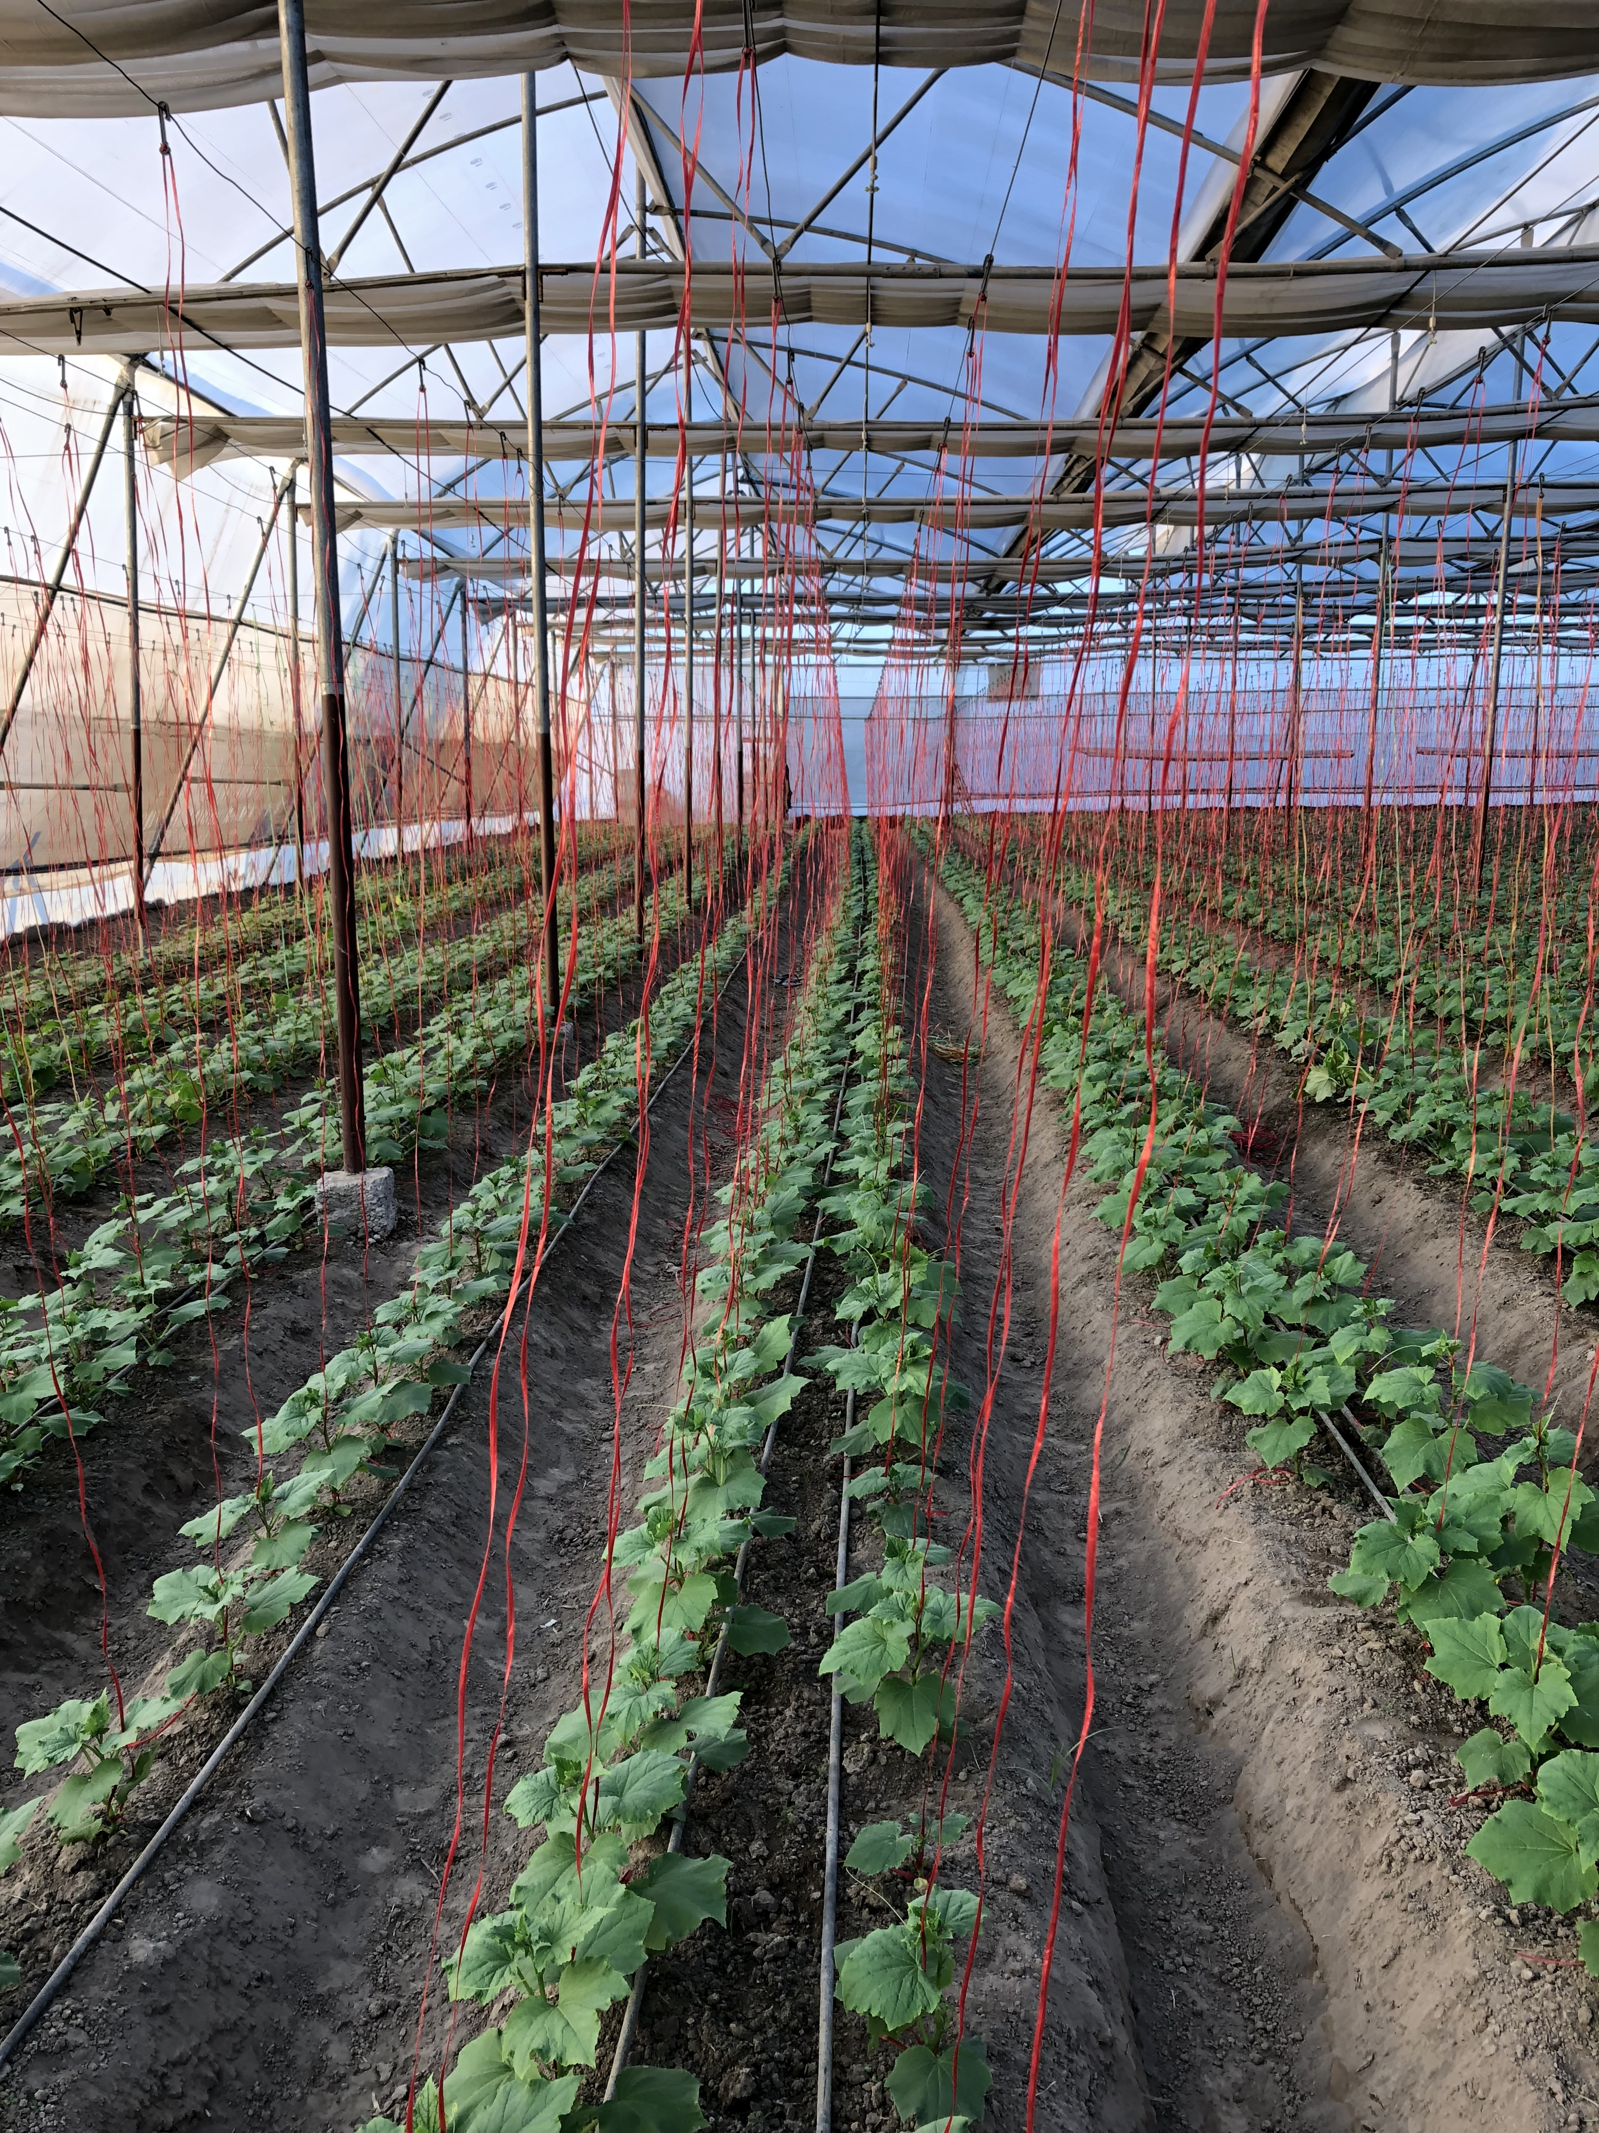

Slide 19
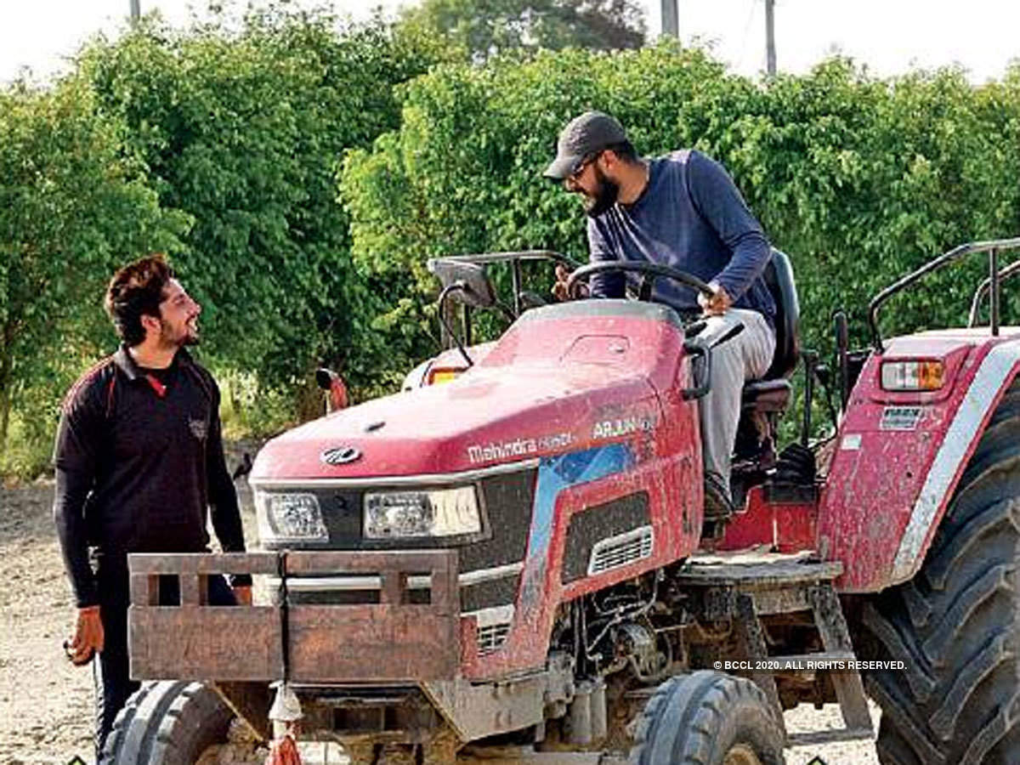
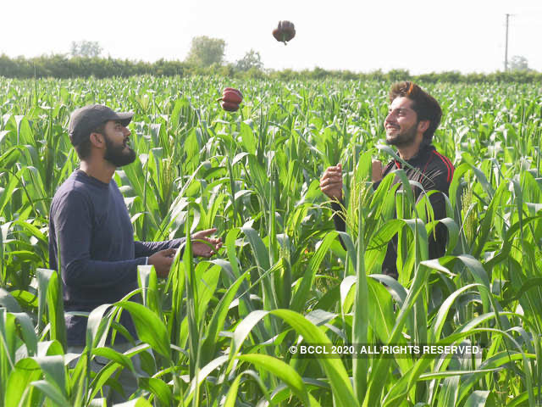
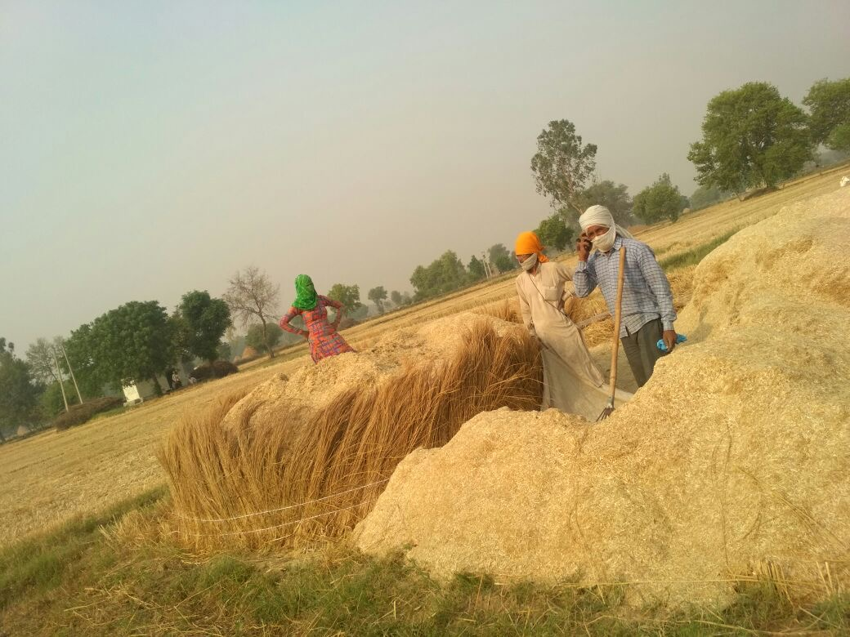

Slide 20
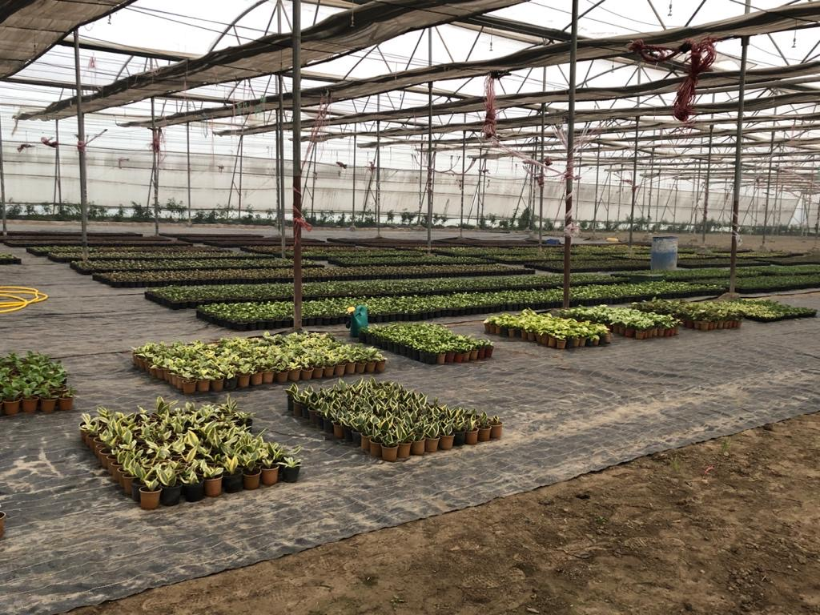
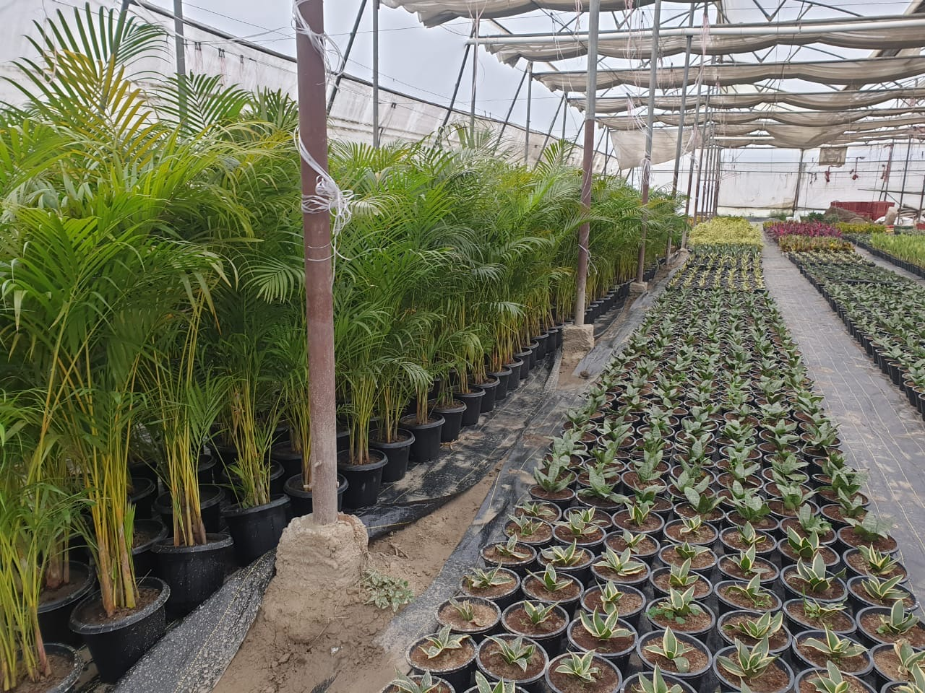

Slide 21
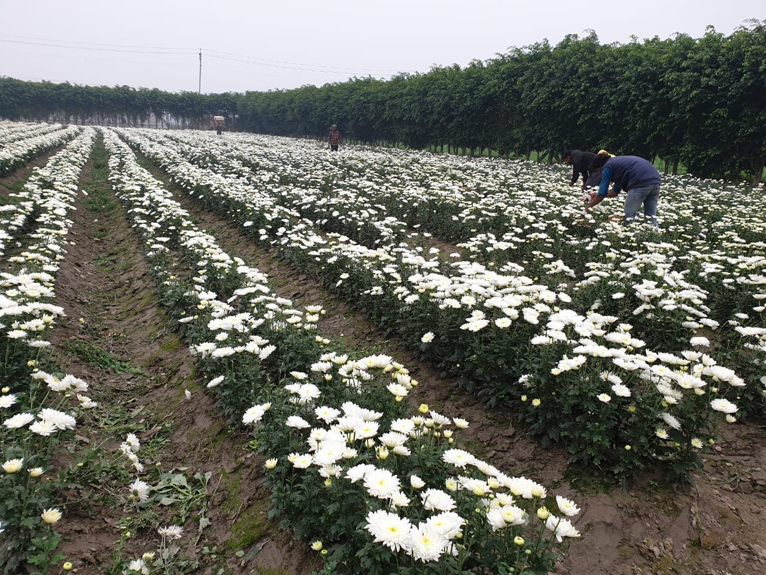
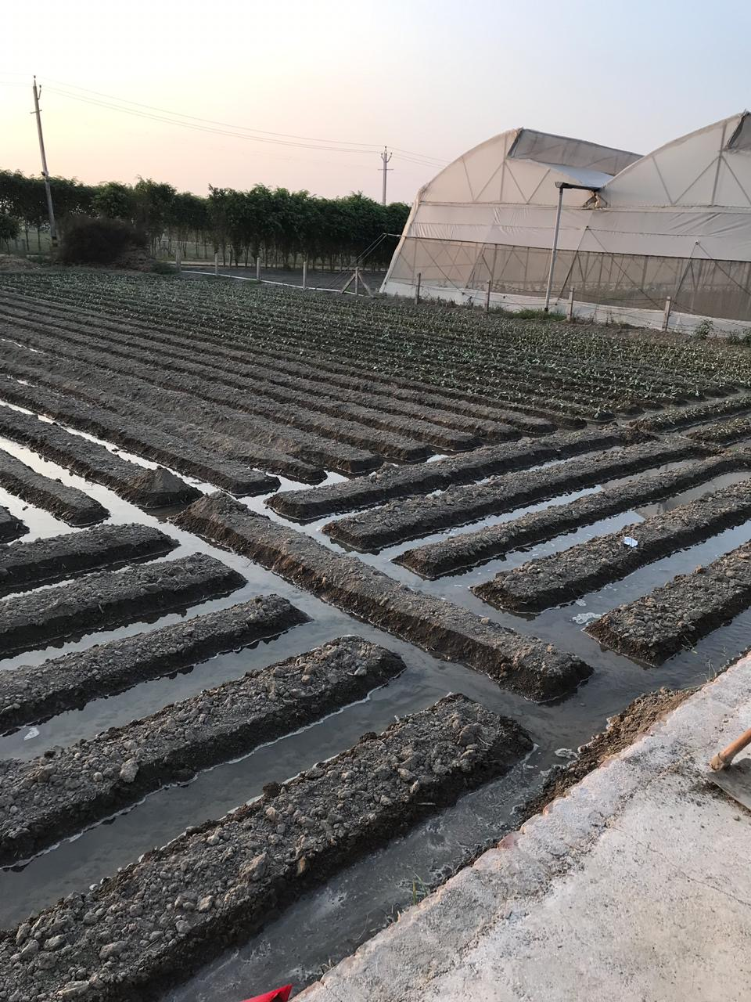

Slide 22
