Slide 1
Exploring the world of Urban Agriculture
Finding Roots in Concrete Spaces

Slide 2
Urban Agriculture
Introduction
What Is Urban Agriculture?
Why Urban Agriculture?
Possibilities..

Slide 3
Back To The Roots: Food Security Through Urban Farming
BACK TO THE ROOTS VIDEO

Slide 4
What Is Urban Agriculture?
In simple terms, urban agriculture is agriculture practiced in urban and peri-urban areas.
Utilizing rooftops, backyards/front yards, balconies, vacant plots, abandoned spaces, public spaces, public parks & institutions, empty spaces in schools, offices, commercial hubs & tech parks and other such confined spaces to grow food.

Slide 5
Why Urban Agriculture?
The urban consumer’s disconnect with food – not knowing who, where and how food is grown
Access to fresh, organic and seasonal food – directly responsible for quality of home-grown food
Converting garbage to compost – reducing ecological damage
Food security
Turning cities green - cleaning the air
Providing joy – fulfilling self actualization needs

Slide 6
POSSIBILITIES: ON GROUND

Slide 7
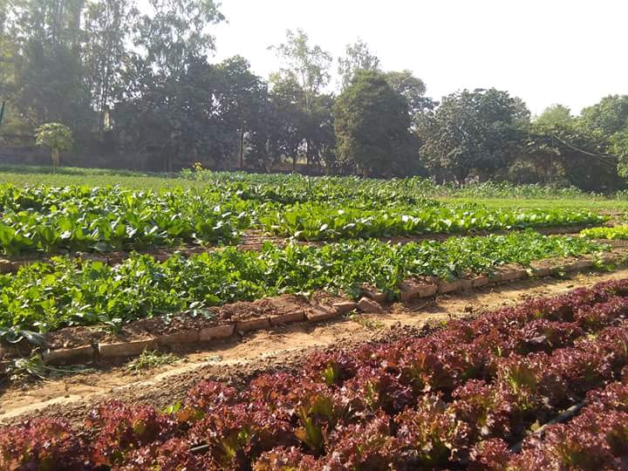
URBAN ORGANIC FARMING

Slide 8
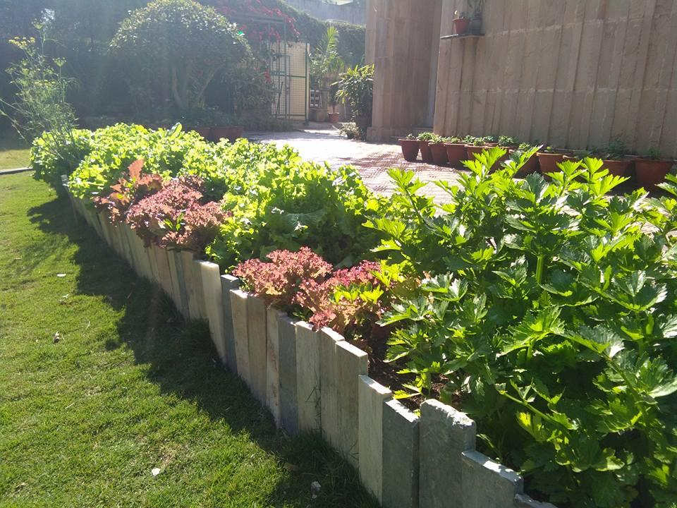
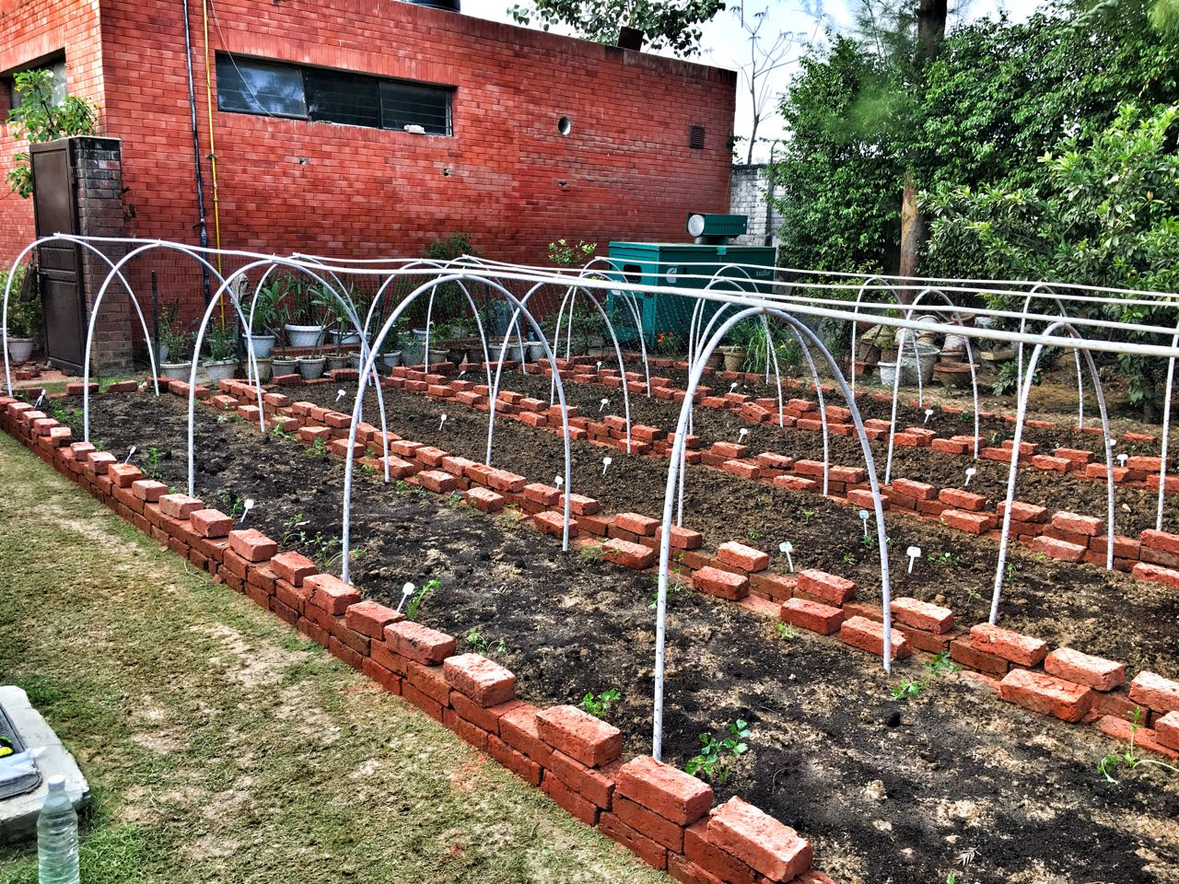
EDIBLE LANDSCAPES

Slide 9
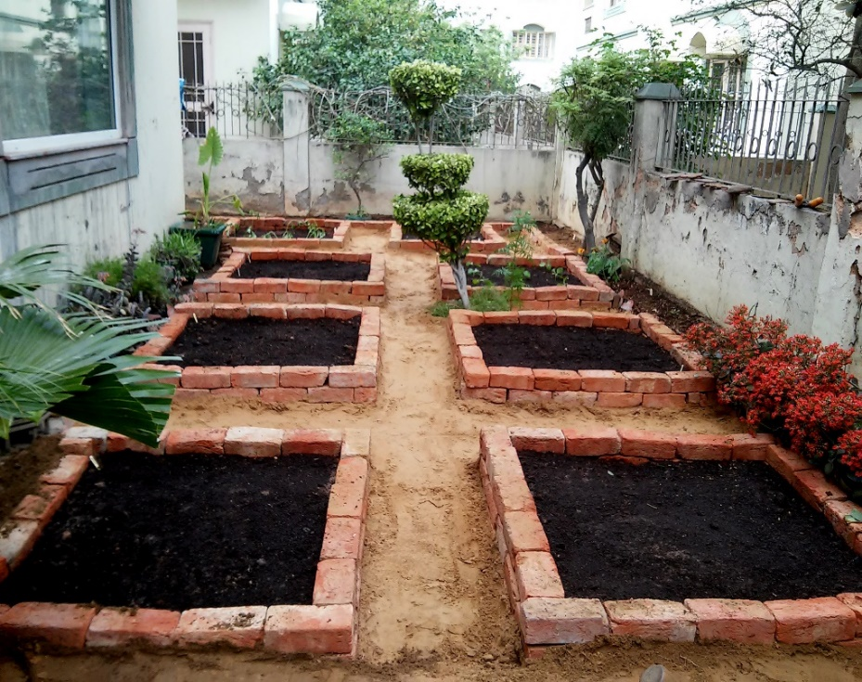
BRICK RAISED BEDS

Slide 10
POSSIBILITIES: ON TERRACES

Slide 11
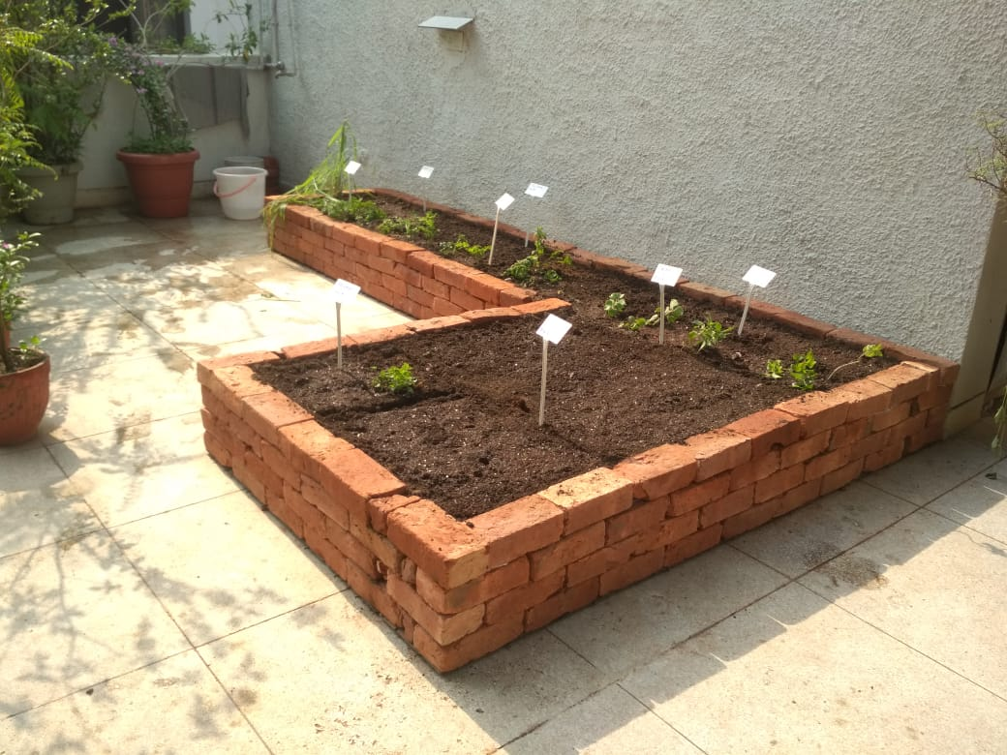
BRICK RAISED BEDS

Slide 12
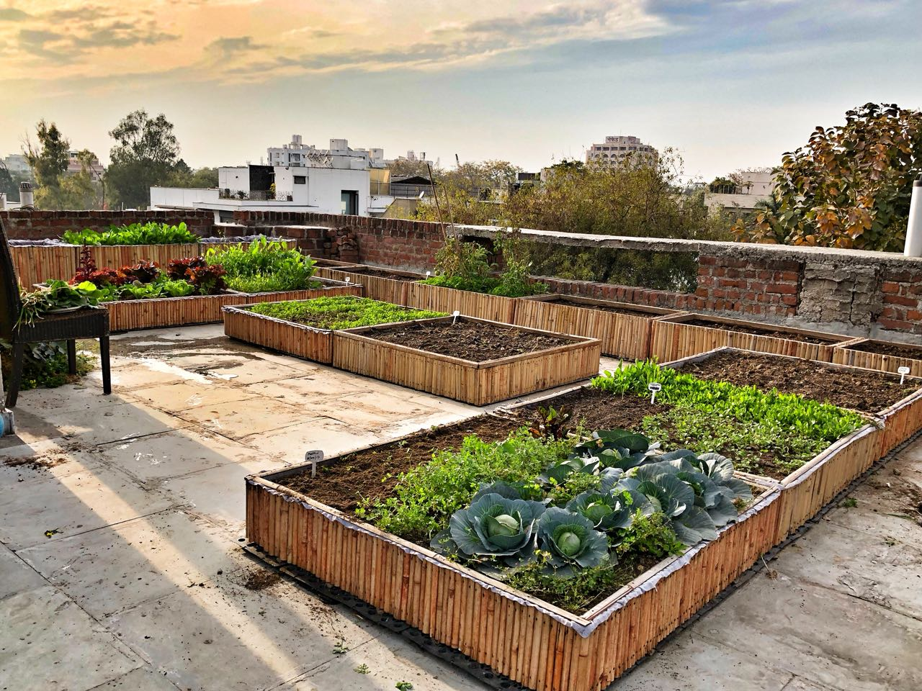
BAMBOO PLANTERS

Slide 13
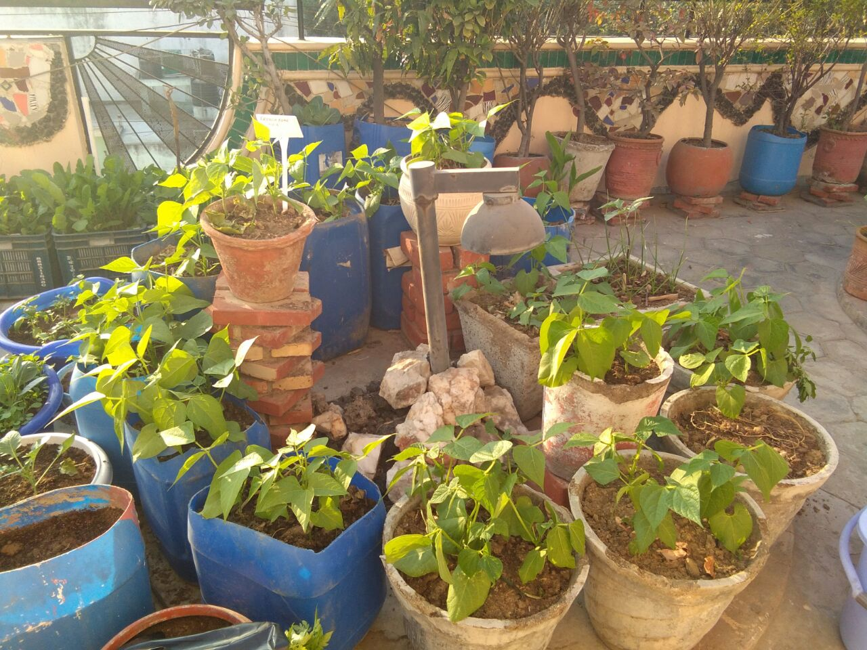
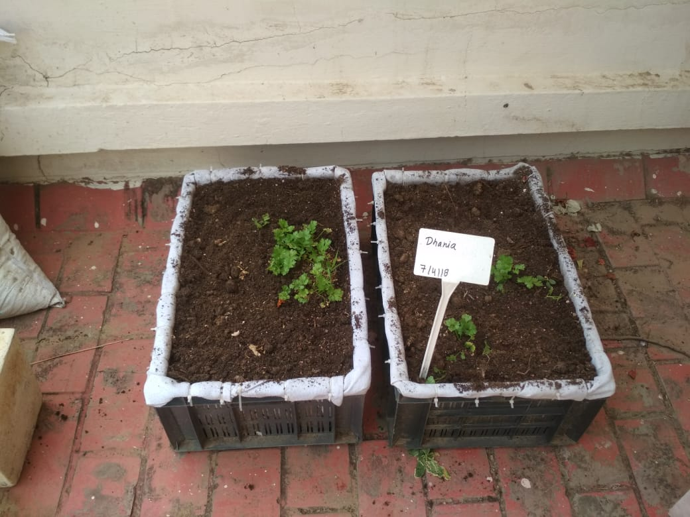
CONTAINERS

Slide 14
FARMLETS

Slide 15
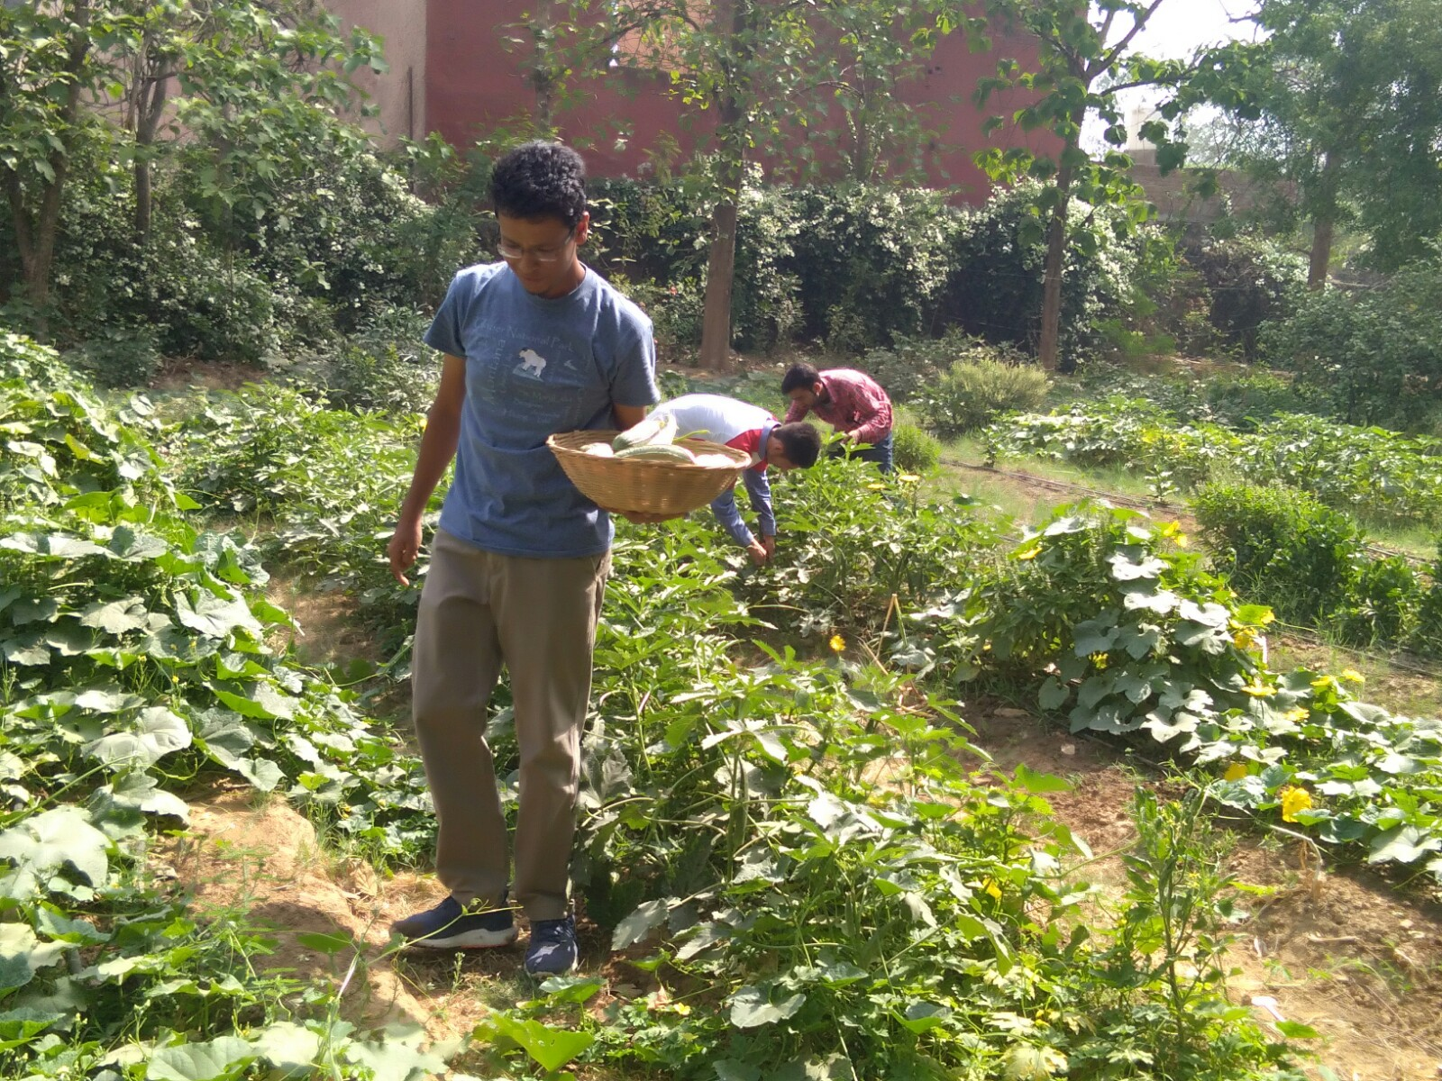
Farmlets
This program permits people who do not own the space to farm otherwise, to rent their own little plot of land (‘farmlet’) in order to grow greens, vegetables, fruits and herbs for their own kitchens.

Slide 16
Farmlets
Like ‘allotments’ in the UK or ‘kleinfarms’ in Germany, farmlets aims to give its renters the chance to grow their own food and re-establish a connection to nature severed by modern life.

Slide 17
Farmlets
Farmletters will finally know the answer to where, how and by whom their food is being grow

Slide 18
About Edible Routes
Edible Routes creates spaces to grow food and strengthen community. We conduct workshops and provide support to kitchen gardeners. We design, build and run food gardens in confined urban spaces like terraces, backyards and balconies. And we plan and manage organic farms in farm houses and outside cities. We also make and sell chemical-free potting mixes, khaad, insecticide and other fun stuff to support this growing community.

