Slide 1
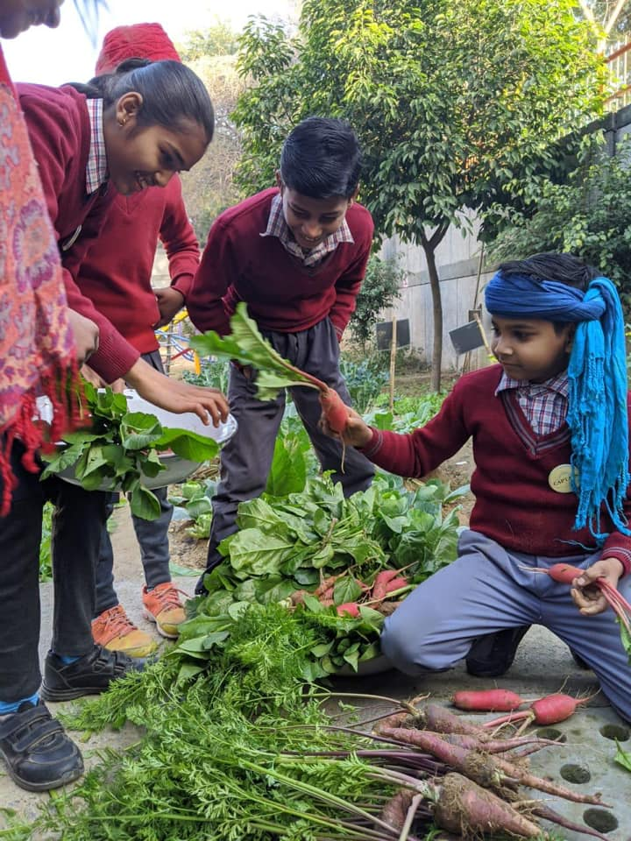
Food Transformation Systems Dr Lakshmi Unnithan Editor, Agriculture World

Slide 2
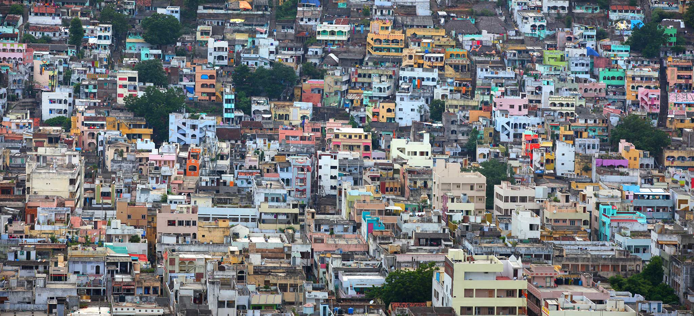
URBANIZATION
By 2050, more than two-thirds of the world will live in urban areas
By 2050, close to 7 billion people are projected to live in urban areas (World Bank Data)

Slide 3
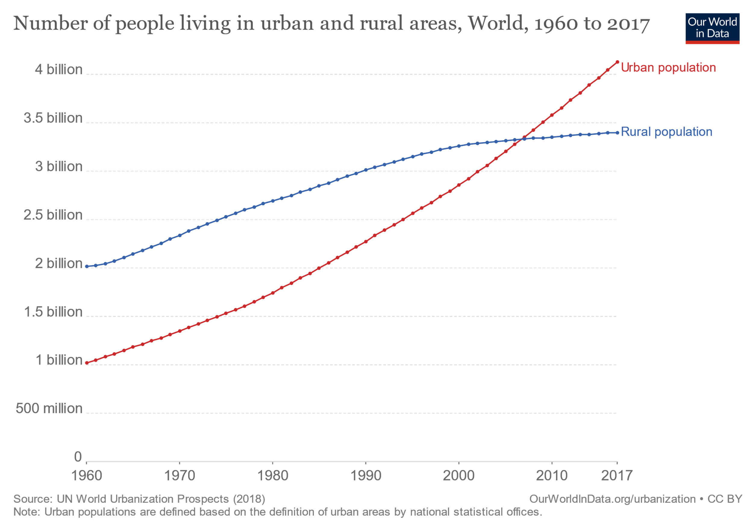
In 2017, 4.1 billion people were living in urban areas.
Over half of the world (55%) live in urban settings.
In 2007 number of people in urban areas overtook the number in rural settings

Slide 4
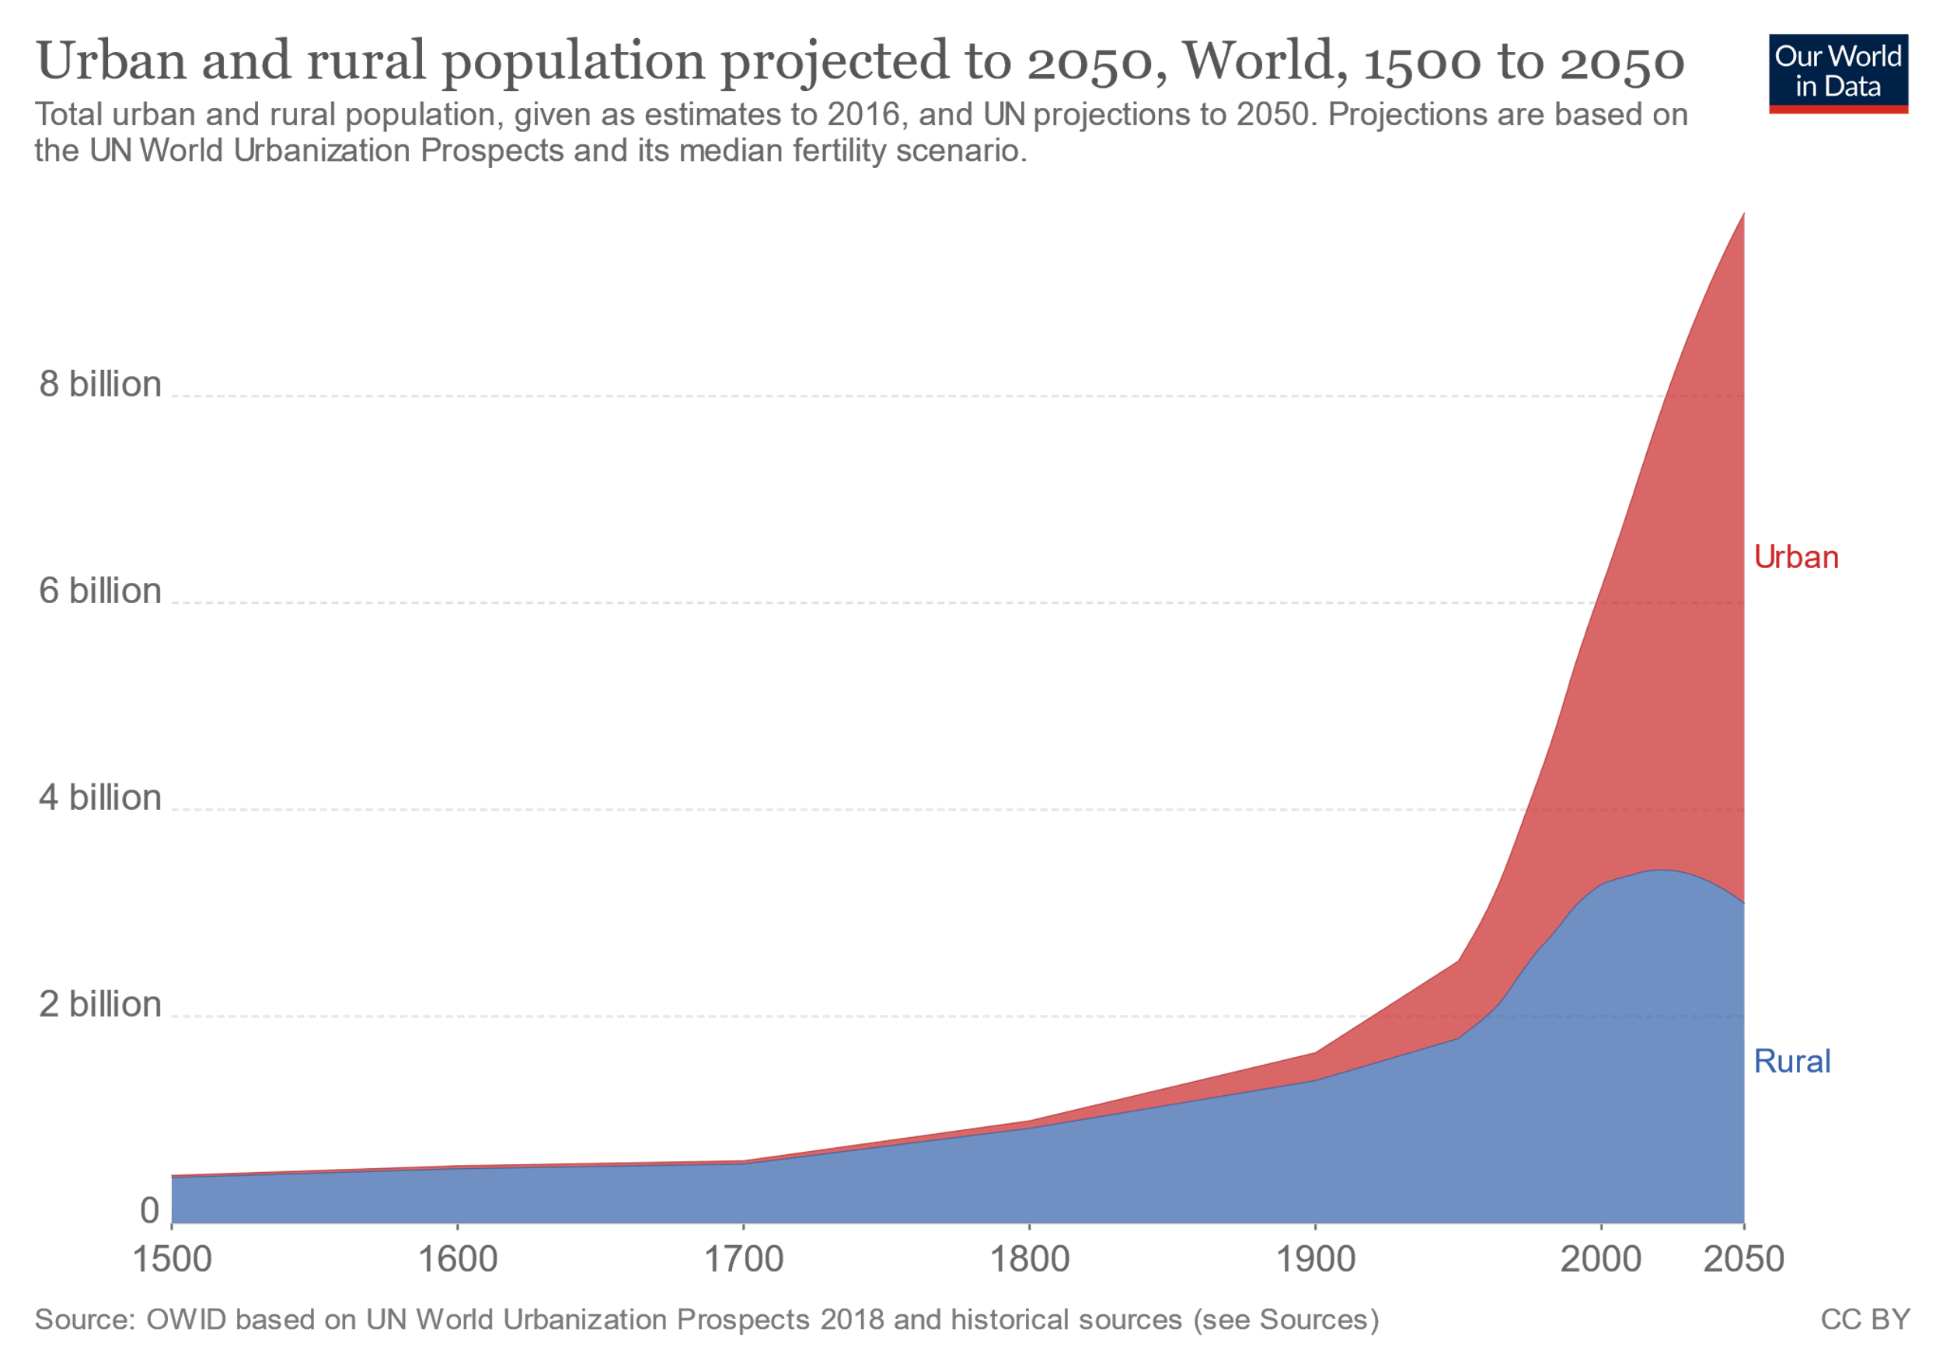
By 2050, more than two-thirds of the world will live in urban areas
By 2050, close to 7 billion people are projected to live in urban areas (World Bank Data)
The latest Report by UN on population speculates that by 2050, the Indian urban population will have increased by 300 million people.

Slide 5
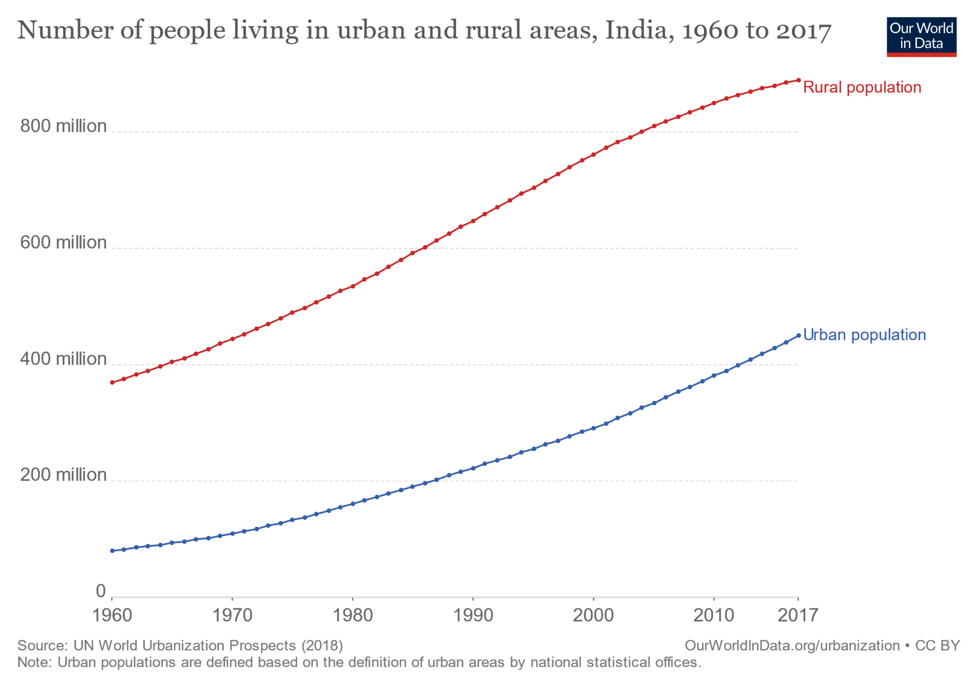
The latest Report by UN on population speculates that by 2050, the Indian urban population will have increased by 300 million people.

Slide 6
Great social issues including housing problems, health hazards waste disposal and shortage of electric power.
Health risks brought about by unsustainable and unplanned development of urban housing, transport, and food systems, include Climate risks, Air pollution, Housing-related health risks, Nutrition insecurity and unhealthy diets, Unsafe drinking-water, sanitation and waste management, Urban green spaces.
Current food systems in cities are challenged
Cities need to explore various opportunities in developing sustainable food systems

Slide 7
Interesting platforms world wide :Urban Agriculture and City Region Food Systems.
An International Pact got signed by 207 cities from all over the world with more than 450 million inhabitants at Milan
Present society : The stages of growing food has now become alien to the palette that consumes it.
Urban agriculture, concept cannot feed the cities, spaces are too less ,potential yields are too low and we remain restricted to certain types of food, but offers high CO2 concentrations !
Investment in Urban Agriculture in Asia: funding patterns not conducive, left unattended, increasingly depended on imported foods.
But it makes possible to rekindle bonds between the urban and natural worlds, between cities and their foodstuffs, as well as 30 % of our nutrition needs.

Slide 8
Informal sector in Indian Cities
Ignored and an unusual focus given to the act of ‘formalizing’ the informal in the planning processes within the city .
The planning and design for urban zones in the global south need to take the informal sector in cognizance and allow for pro- visions to augment them (Sandeep Menon, AW,Jan).
Supermarkets are in many ways a symbol of these forms of distancing.
The current trend is to bring food production closer to consumers. Reviving ancient practices like the 19th century Paris, market gardens made it possible to directly produce and consume within the city limits.

Slide 9
Multi Disciplinary Initiatives
Urban Food Policies and Programmes
The Urban Food Actions Platform is a partnership between FAO, the Milan Urban, The Urban Food Policy Pact (MUFPP) Secretariat, and international networks of local and regional governments: C40, ICLEI-RUAF City food network, ORU-Fogar and UCLG.
The Agenda 2030, Paris agreement recognizes resilient and sustainable urban development and management as “crucial to the quality of life of our people” and includes a specific goal for urban areas (SDG11): “ make cities and human settlements inclusive, safe, resilient and sustainable”

Slide 10
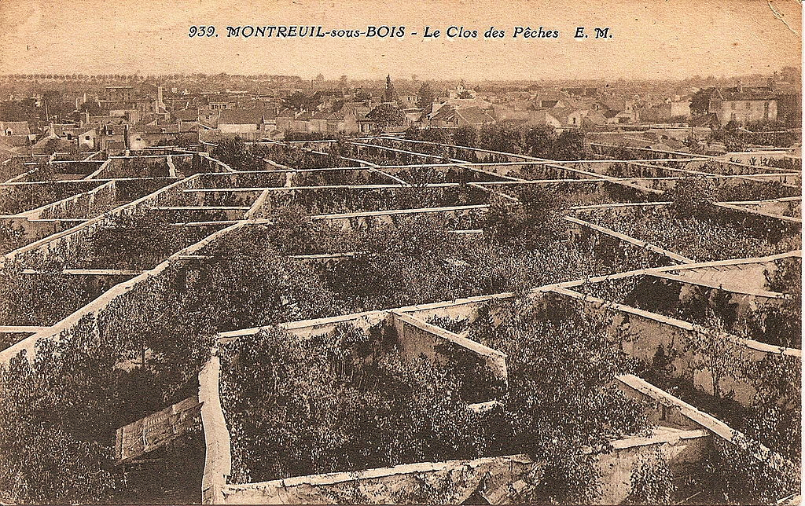
Cities across the Globe Committed to Action
Urban Fruit Walls
Urban Farming in the 1600s. These crops were grown surrounded by massive "fruit walls", which stored the heat from the sun and released it at night, creating a microclimate that could increase the temperature by more than 10°C

Slide 11
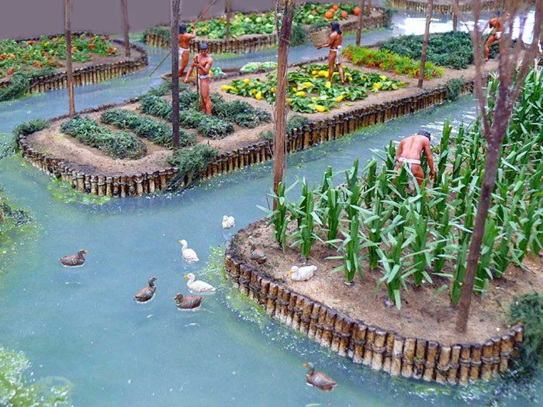
Chinampas
Invented by the Aztec civilization in the region of Lake Xochimilco, south of Mexico City. Sometimes referred to as "floating gardens," Chinampas are artificial islands that were created by interweaving reeds with stakes beneath the lake's surface, creating underwater fences.

Slide 12
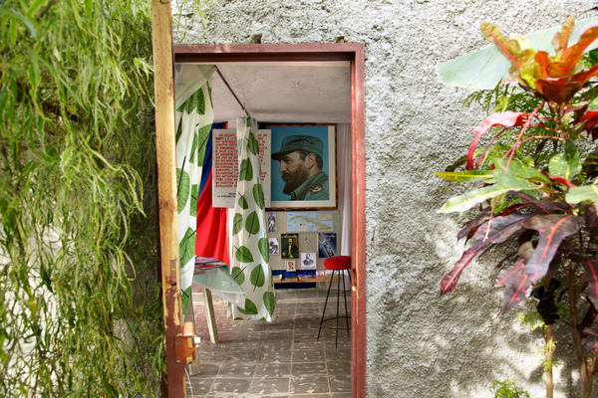
The Havana Model
Cubans see their urban agriculture movement as a possible solution as the world begins to grapple with increasing prices and demand for food and fuel. Many other countries have begun to use the Cuban experience as a model as locally grown, organic produce becomes more popular worldwide. In 2007, Fidel Castro warned in the first published essay after his illness: "More than three billion people in the world are being condemned to a premature death from hunger and thirst" by diverting food crops to biofuels

Slide 13
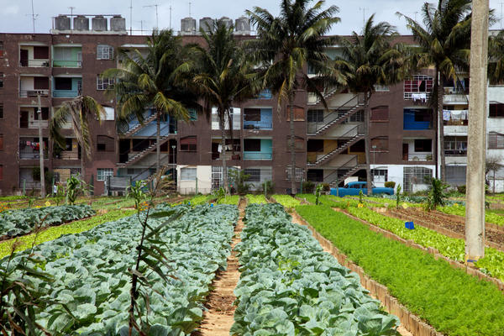
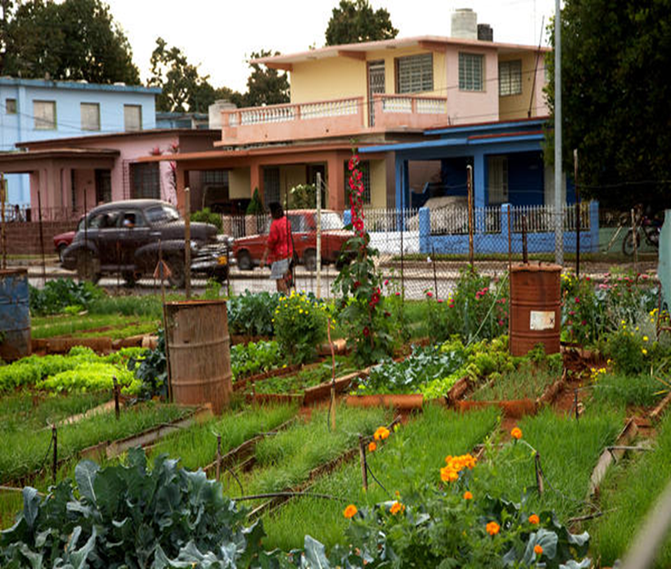
Cuba

Slide 14
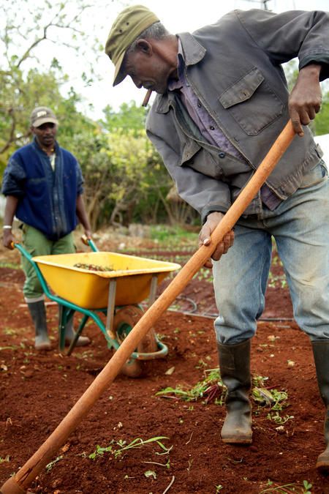
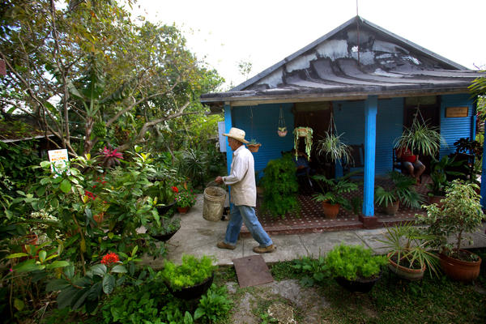
Cuba

Slide 15
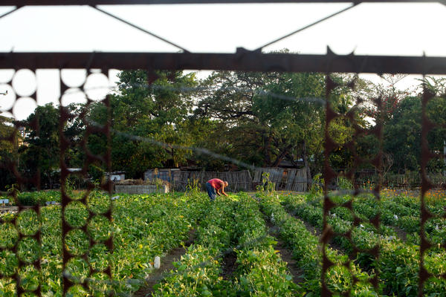
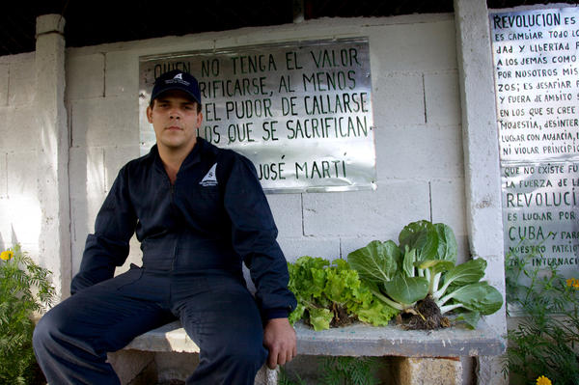
Cuba

Slide 16
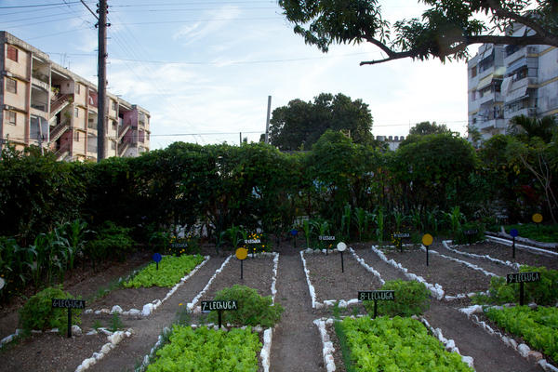
International Food Policy Research Institute found that “Urban agriculture provides an estimated 15% of all food consumed in urban areas worldwide and is likely to double that share in the next couple of decades.” In contrast, Havana seems saturated with production. Indeed, 90% of Havana's produce comes from local growing.

Slide 17
Assistance from FAO and other organizations has helped introduce various types of urban gardening in Latin American cities.
Successful urban and peri-urban agriculture include Hanoi, Shanghai. In densely populated Hong Kong, 45 percent of local vegetable needs were met through intensive cultivation on only six per cent of the land area.
In a few rich countries like Japan and Netherlands (as also some developing nations in Latin America), the urban farmers are given government protection and encouragement through favorable land use regulation, tax concession, and other support measures.

Slide 18
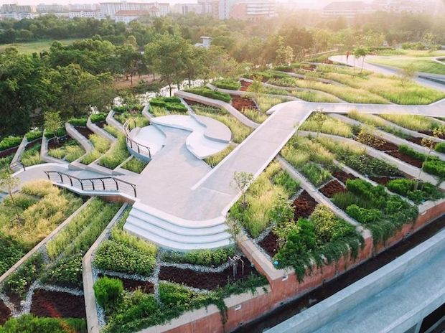
Bangkok’s Thammasat University, one of the oldest in Thailand, has a new claim to fame: Asia’s largest urban rooftop farm.
The 7,000-square-metre space mimics rice terraces in the north of the country and can help curb some of the impacts of climate change.
Bangkok, built on the floodplains of the ChaoPhraya River, is forecast by climate experts to sink by more than 1 centimeter annually and become one of the urban areas to be hit hardest by extreme weather conditions in the coming years.

Slide 19
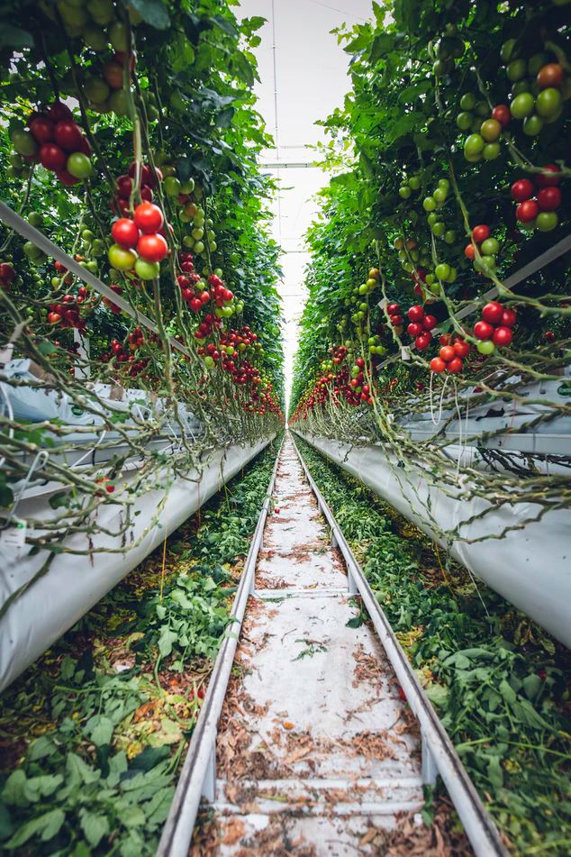
Farm One is an indoor vertical farm in Manhattan using hydroponic technology to grow rare culinary herbs for New York City’s finest restaurant
chefs.
Deep beneath a South Korean mountain, a high-tech farm has been built inside an abandoned tunnel. The 2,000-feet-long (600meter) tunnel is being used to grow salads, leafy greens, and strawberries.

Slide 20
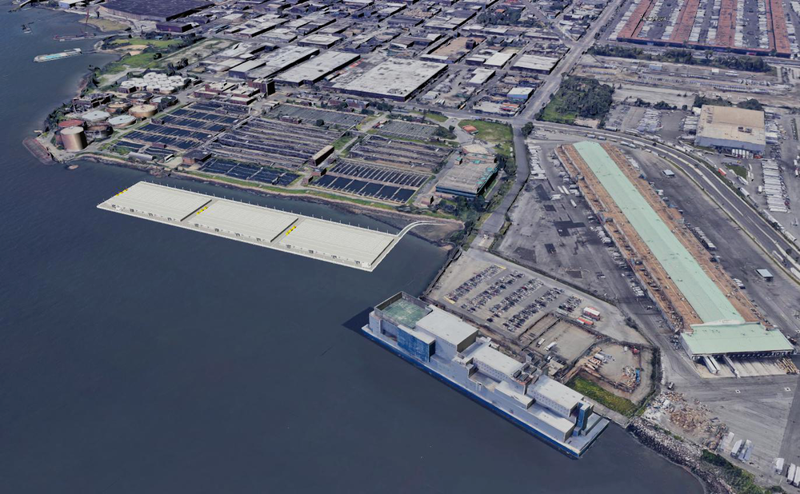
Cities that are surrounded by water have been constructing their coastal areas to build structures that are resilient to storm surge. Aqua Ark’s most recent water-borne venture is constructing the largest farm in New York City. 4 acres of horizontal growing area, a scale otherwise unattainable in NYC. This is a unique opportunity for farm operators to grow food in such close proximity to the largest food distribution center in the world.

Slide 21
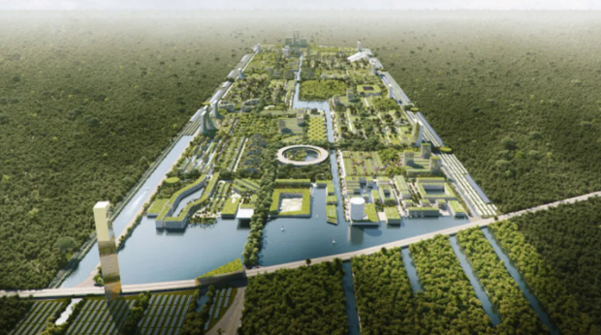
A Milan-based architecture firm, Stefano Boeri Architetti, has laid out plans for what has been called a smart "forest city" located near Cancun, Mexico.
The city is designed in a way that allows its residents to be completely self-sustained; this includes all water, food, and power needs. This city will be spaced out over 557 hectares. Out of the 557 hectares, 400 of those will be taken up by 7,500,000 plants

Slide 22
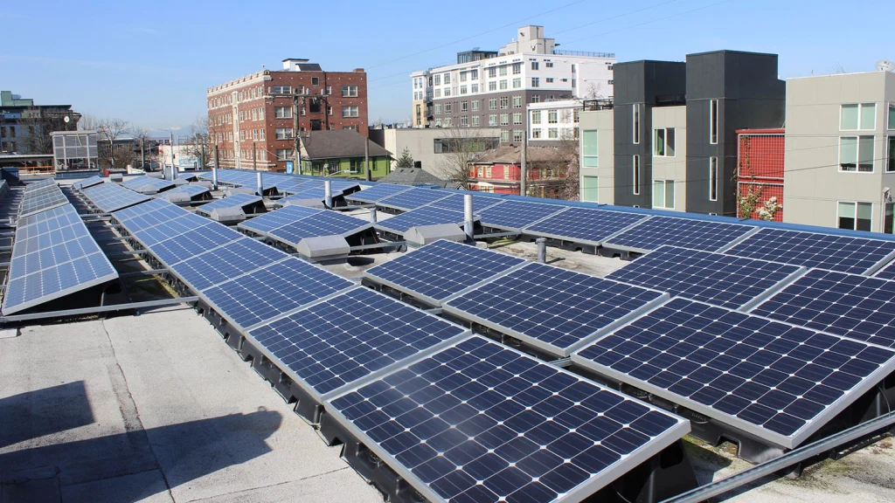
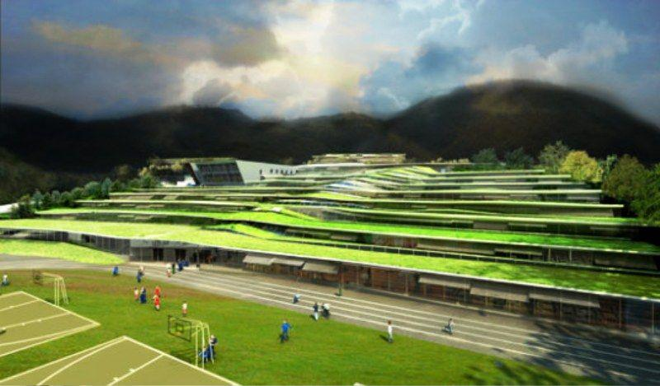
Green Roofs are very popular in Germany and Australia as well as Canada’s City of Toronto, where law has been in force since 2009.France recently passed a law requiring roof tops of all new buildings in commercial zones to be fully or partially covered in plants or solar panels.

Slide 23
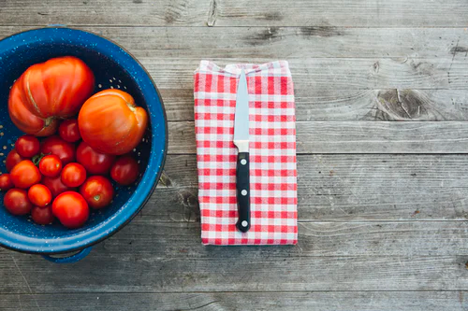
India
Pune, Smt Lata Shrikhande, began in the 1980s.
Dr R.T.Doshi, Pune
Dabholkar, Maharashtra
Bangalore Terrace Gardening Group
Oota from Thota ,Bangalore
Farm 8 Work in progress :Perma culture space of 3 Acres in Delhi
Village Story: Experimental square foot community in Bangalore
Sowgood: Farm for children by Children, New Delhi

Slide 24
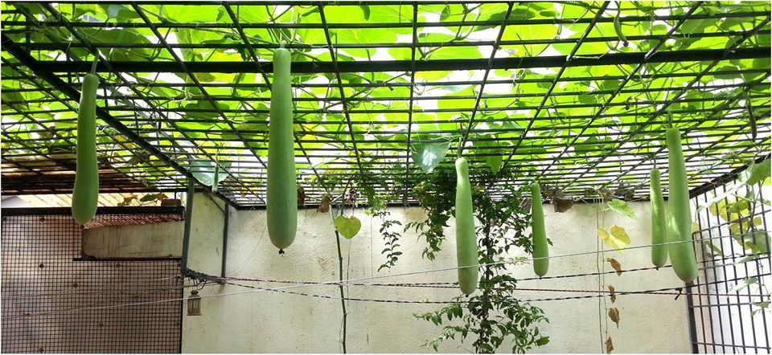
Bangalore Terrace Gardening Group

Slide 25
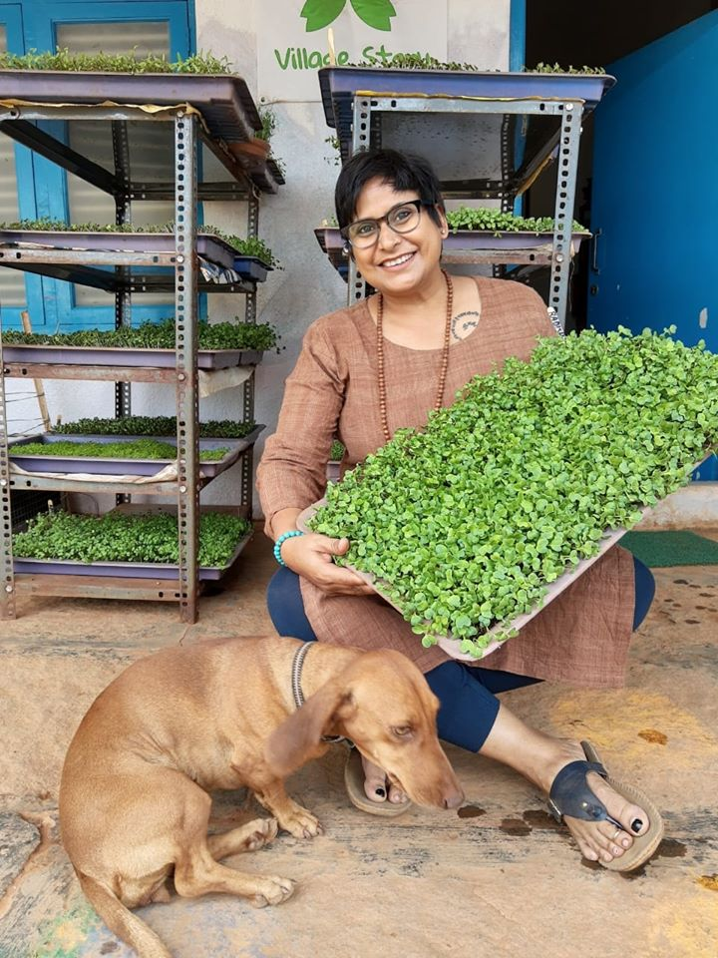
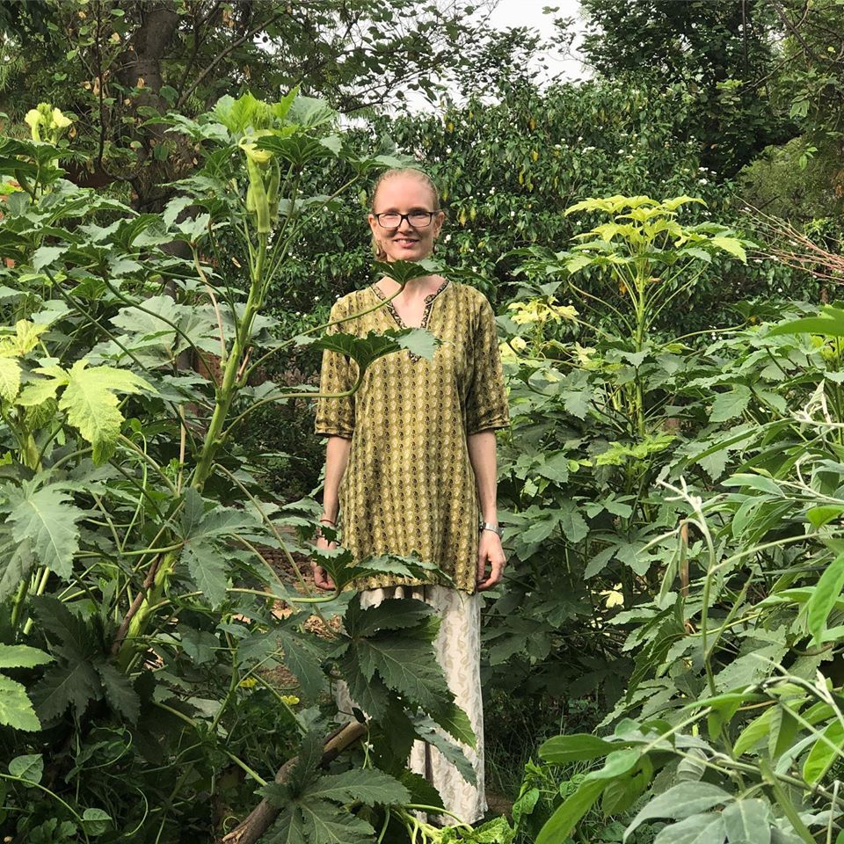
Village Story:Anamika and Farm 8

Slide 26
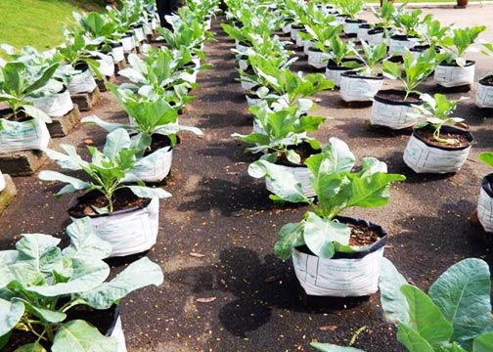
Kerala
Promoting Urban Roof Top Gardening, Aquaponics, Drip Irrigations Systems, Hydroponics.
State Agriculture Departments, Kerala Horticulture Mission, Kerala
Department of Environment and Climate Change(DOECC)
Vegetable fruit promotion council(VFPCK)

Slide 27
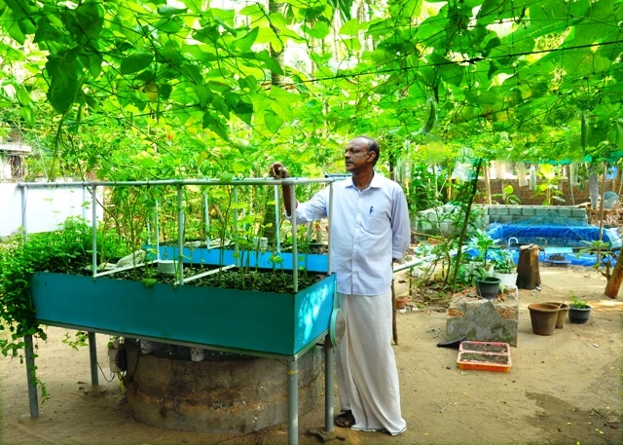
Aquaponics

Slide 28
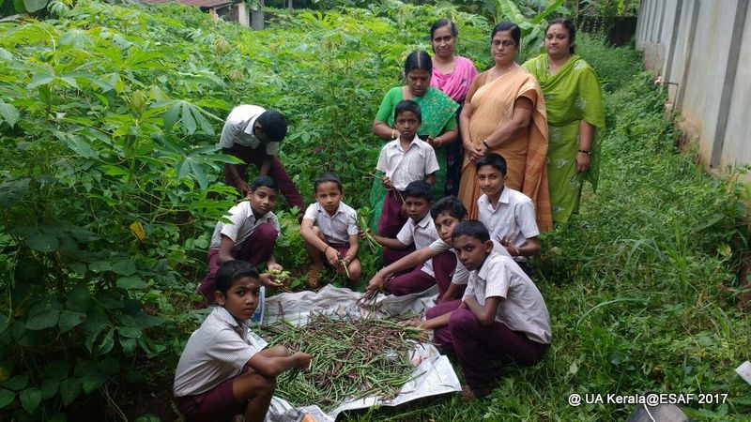

Slide 29
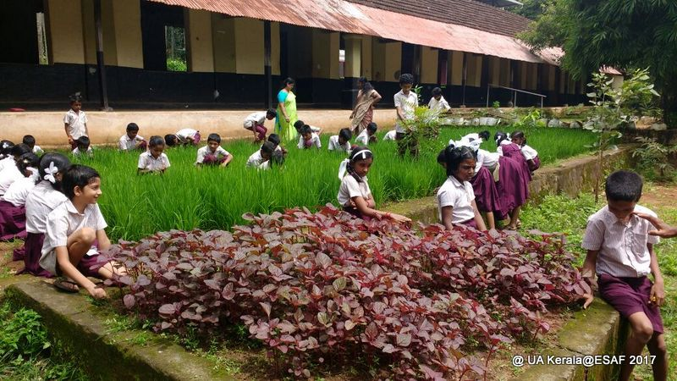

Slide 30
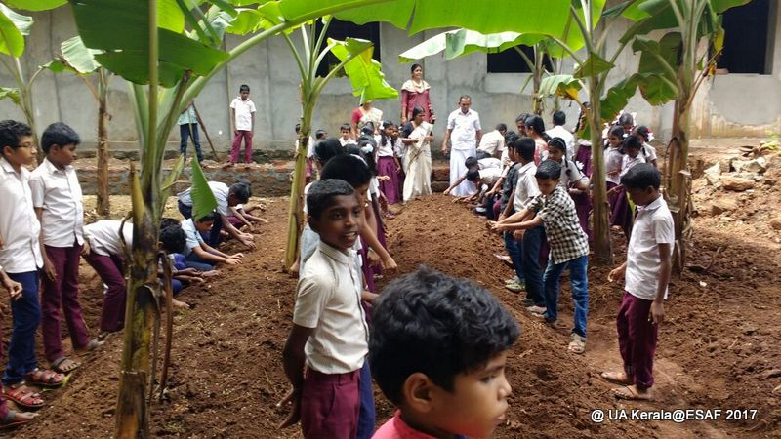

Slide 31
Essentials in Creating Sustainability in Cities
Better innovations in how food production can be reimagined as an integral part of city living.
The notion that food has nothing to do with urban planning and design needs to be revisited.
Spatial designs and urban inserts need to be conceptualized keeping in mind the issue of food security as well to ensure a resilient urban future.

Slide 32
City Region Food Systems
Cities need Practical guidelines
Political will and the use of available policy and planning instruments: infrastructure and logistics, public procurement, licenses, and land-use planning.
Each City region should then develop a variety of strategies by which to improve its food system.
There is no ‘one size fits all’ approach to addressing challenges and opportunities related to city region food systems.

Slide 33
City Region Food Systems
Losses, Food wastage throughout the supply chain reduced
Nutritious food, impact the quality of diet, Food Logistics Efficiency
Collaboration between all levels of government and non governmental organizations, Individuals, Farmers, Collectives
Multi-stakeholder food planning/ policy councils, which many cities, including Toronto and Belo Horizonte, have successfully implemented.
How policy at all levels can provide greater support to promote positive, local practices.

Slide 34
Best Practices
Food Policy Councils (FPCs),Food Labs and similar groups like multi-stakeholder food forums/platforms, food policy networks, food groups are to be formed.
They research and bring perspectives to shareholders on developing food systems to bring about changes, to address the challenges and bring about innovative solutions to influence policies and planning in food systems.
The Toronto Youth Food Policy Council, the only youth-led group (TYFPC)founded in 2009 is best encapsulated as working to engage, inform and mobilize young people around food and food policy issues. They will share experiences and perspectives on the many challenges that they are currently facing in their food system at the policy tables is Unique.

Slide 35
Each city needs to have hundreds of local food initiatives, such as allotments, food waste platforms and farmers markets, but these are far removed from professional large-scale food producers.
Local food strategies and farming could be enhanced by directing agricultural funds to clusters of cities and municipalities so they can create regional food strategies and develop direct farm links.
This would make help strengthen local food policies and help farmers from being less dependent on the world market and large companies.

Slide 36
Designing Holistic Food Systems
Cities and Regions need to connect better with traditional farmers who produce on a larger scale
Sustaining the urban link with rural is so important to keep us still weaved to our cultures and Ingenious knowledge systems.
An Integrated perspective needs to be developed keeping in mind the above social and ecological dimensions. Strategic approaches need to be made to bring in sustainable actions in individuals, communities and larger collectives, and across all scales, from the local to the global.
Focus on adopting and implementing policies that encourage the Making of Sustainable Cities.

Slide 37
Thank You

