Slide 1
Valorization of Organic waste into Biofertilizers: An Approach towards Urban Farming

Slide 2
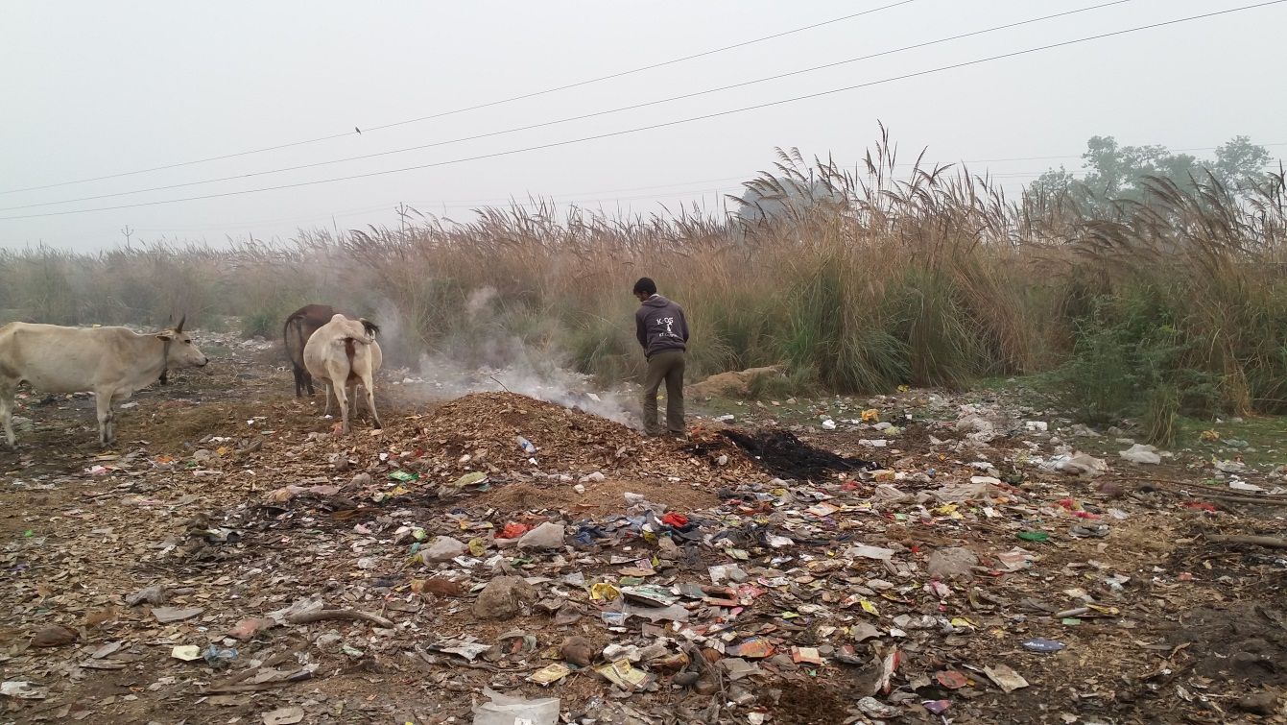
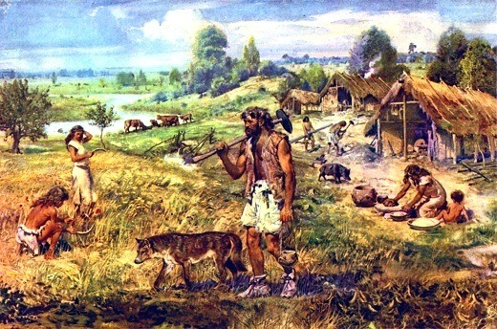
Stone Age
Golden Age
Garb-Age

Slide 3
PROBLEMS
301.58 LMT of Chemical fertilizers are used every Year³
Unscientific disposal of Solid Waste emits GHG
1150 Million Tonnes of Vegetable waste¹ + 300 Million Tonnes of crop residue² is produced annually in India
Leachate contaminates groundwater table
For 1 Ton of N fertilizer manufactured and used, 13.5 Tonnes of CO₂ is emitted⁴
Sources: 1: Estrada-Bonilla et al., 2017
2: Dept. of Fertilizers, GoI
3:Du et al., 2018; 4: Zhang et.al, 2012

Slide 4
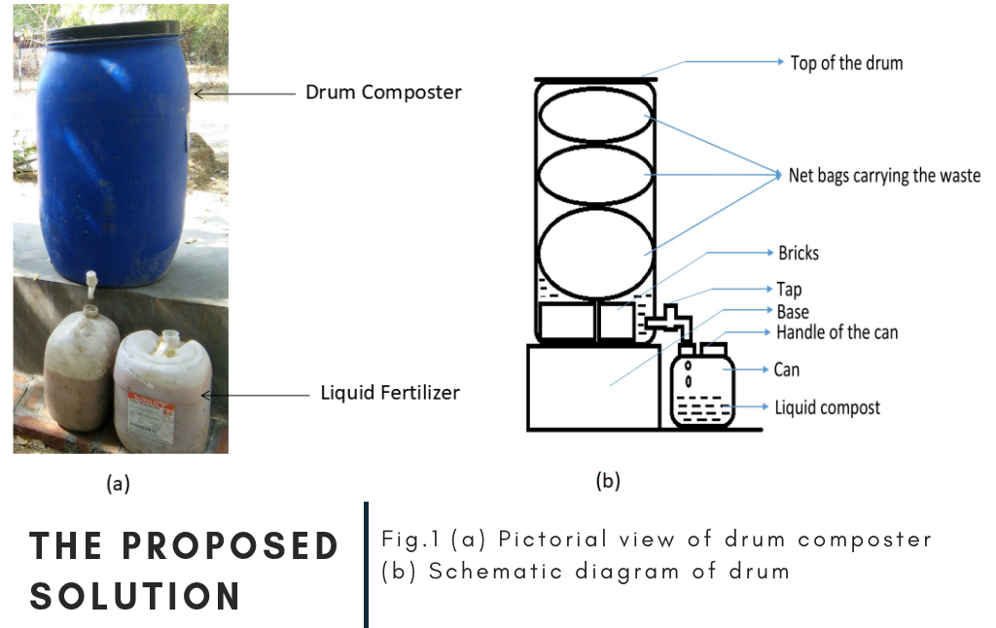
+
Inoculum
500 mL+ 4 L water
Organic Waste
(150 Kg)
(200 L)
+ Incoculum
(40 L)

Slide 5
1
Faster formation of liquid/Solid Fertilizer
Liquid as well as solid fertilizer within 12-20 days.
Bio-Fertilizer & Biocontrol agent
The inoculum developed has bacterial strains of genus Bacillus they have capacity to form a biofilm, endospores, pH extremes, cyclic peptides, antibiotics various hydrolytic enzymes like lipase, glucanase, and chitinase causing faster degradation of agro-waste and disease suppression.
2
NOVELTY
3
Bio-augmenting Inoculum and Fertilizer formed acts as Bioinoculant
The process can be scaled up for bioconversion of organic waste on a large scale in a much sustainable way.

Slide 6
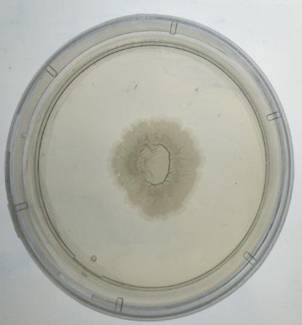
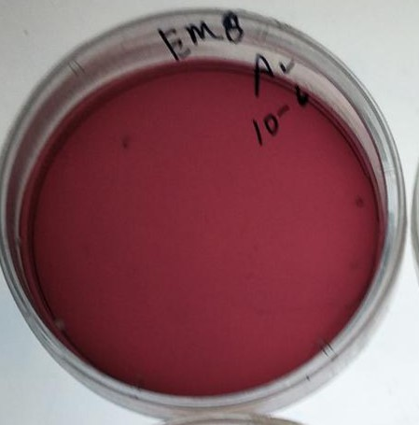
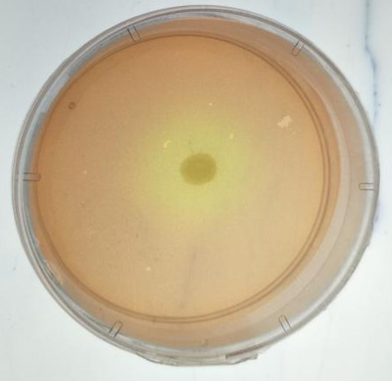
Bacillus haynesii strain
Gram Positive
EMB Agar
Biofilm Formation
LB Media
HiChrome Bacillus Agar
FeSEM Image

Slide 7
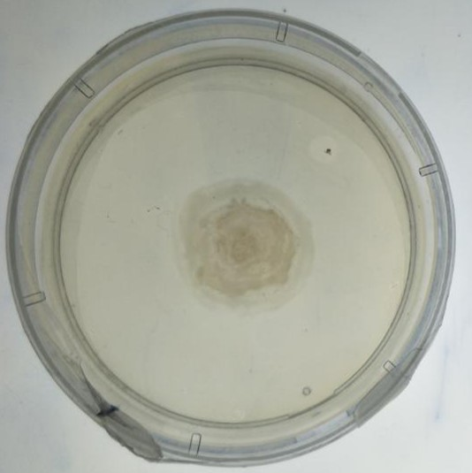
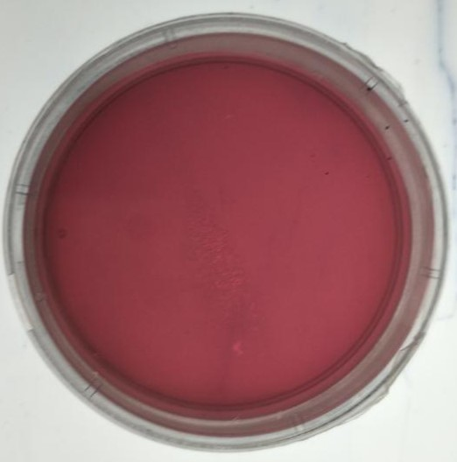
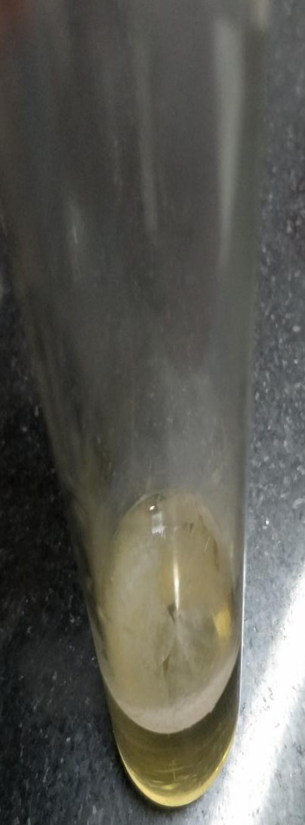
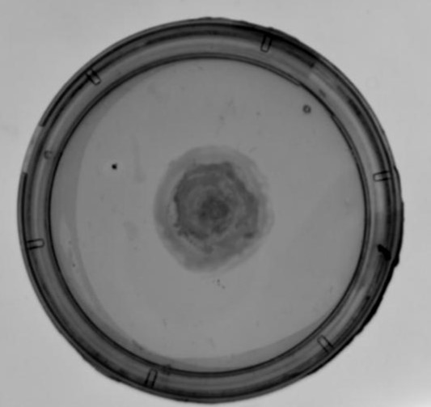
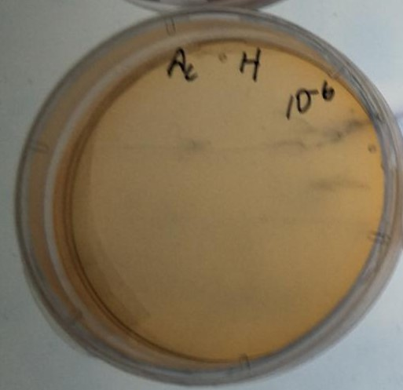
Bacillus australimaris strain
Gram Positive
EMB Agar
LB Media
HiChrome Bacillus Agar
Biofilm Formation

Slide 8
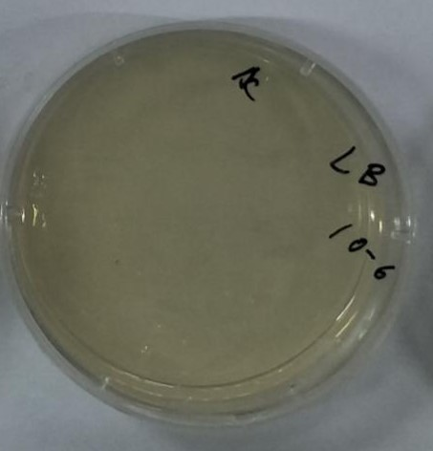
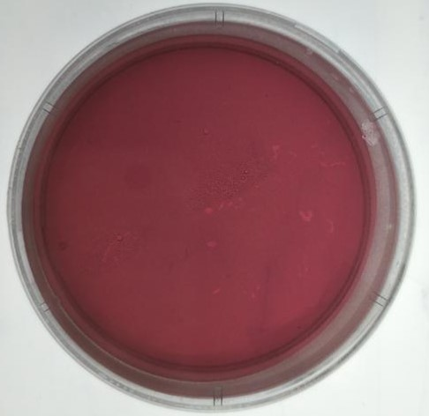
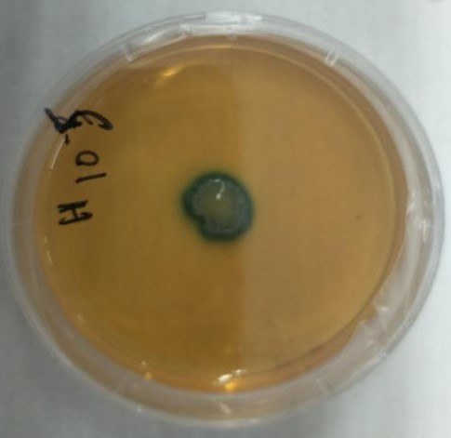
Bacillus safensis strain
LB Media
EMB Agar
Gram Positive
No biofilm formation was observed
Green Colony in HiChrome Bacillus Agar
Indicator of Bacillus strain
HiChrome Bacillus Agar

Slide 9
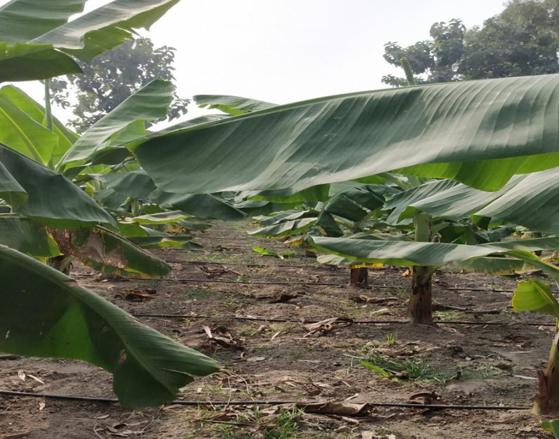
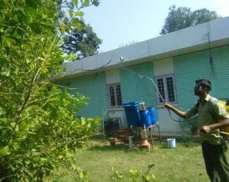
Flowering Plants (IIT Kanpur Campus)
Green : With Compost, Red: W/o Compost
Banana Trees grown by Liquid fertilizer through Drip Irrigation Pilibhit district (U.P.)
Garlic Plants at Saksupurwa Village Kanpur (U.P.)
Green : With Compost, Red: W/o Compost
Spraying of Liquid fertilizer on Guava Tree
(IIT Kanpur Campus)

Slide 10
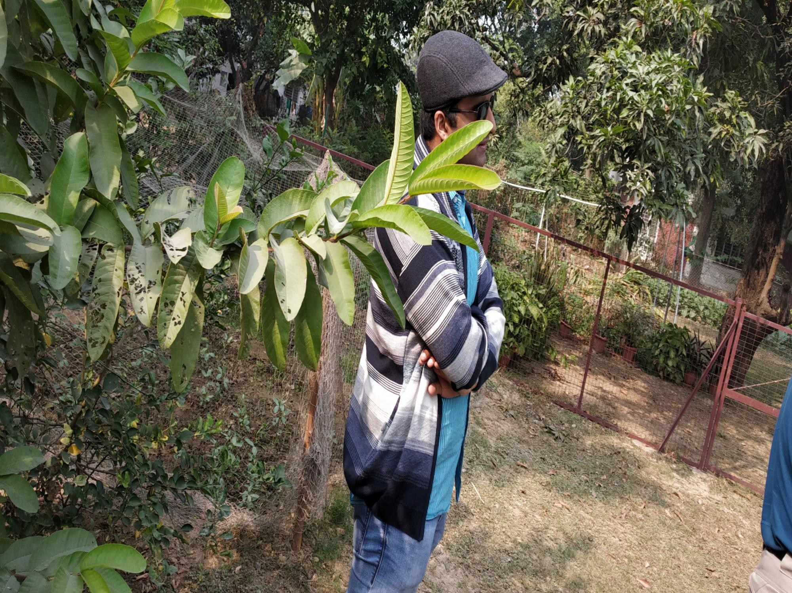
After using our Compost (Biocontrol agent ), IIT Kanpur (U.P.)
Before using our Compost, IIT Kanpur (U.P.)

Slide 11
Economically sound and eco-friendly technology
Products are easy to use and can be incorporated with modern Irrigation Techniques
Low investment and maintenance cost is needed with min. human intervention
Feasibility

Slide 12
Key Sources
Institutional Premises
Urban Local Bodies
Vegetable suppliers
Agro-food industry
Organic Farmers
Value Proposition
Biofertilizer market is estimated to be valued at $2.0 Billion in 2019, growing at 11.2% rate through 2025.
Increasing demand of organic products.
Drip Irrigation/Sprinklers method is supported by biofertilizers
Customers
Farmers & Farmer associations
Residential areas
Public administration
Business Model
Revenue Streams
Service provider of waste management
Selling of Biofertilizer to farmers
Selling of compost produced
Associating with Govt. bodies such as IARI, CSA for linking with farmers.
Our Partners
Unnat Bharat Abhiyan, IIT Kanpur
Nagar Nigam Kanpur
Working with KhetKisan FPO with 600 farmers
Manas gram Organics Pvt. Ltd.

Slide 13
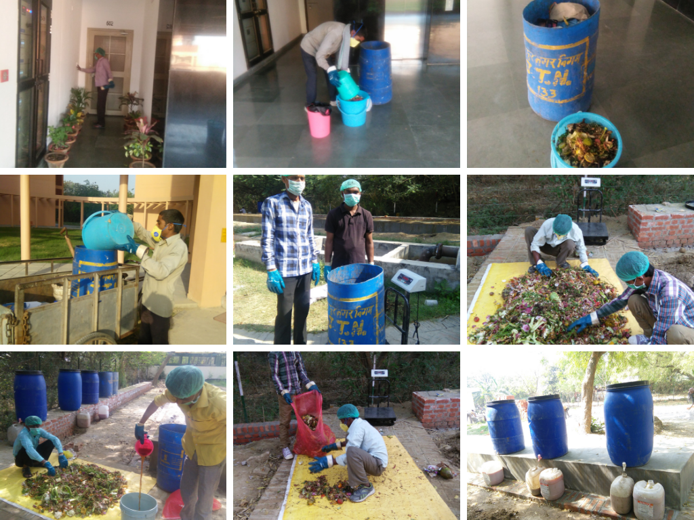
Preliminary Work
Dec 2016-Feb 2018: Pilot Scale Testing
March 2018-Till Date: Implementation at IIT Kanpur campus

Slide 14
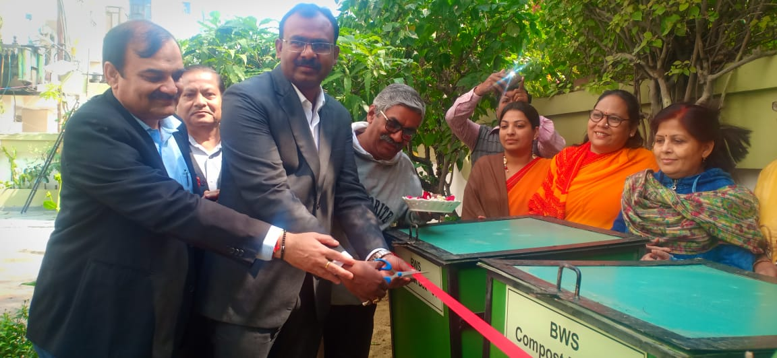
Some Pictures of our Work
Inauguration of drum composter system by municipal commissioner, in Barsana Apartment, Kanpur. An ongoing process in Imperial Residency Apartment, Kanpur, U.P.

Slide 15
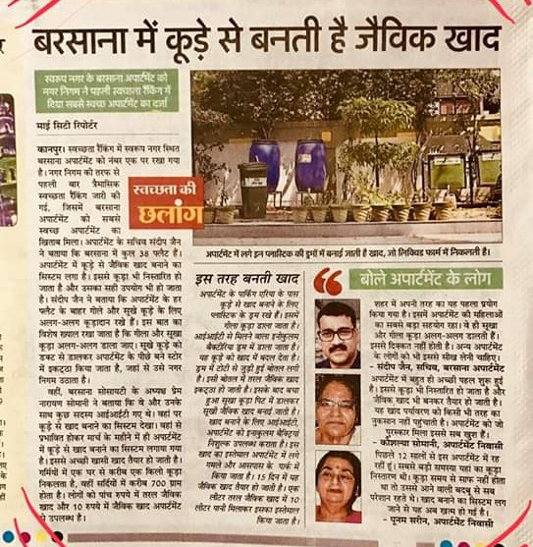
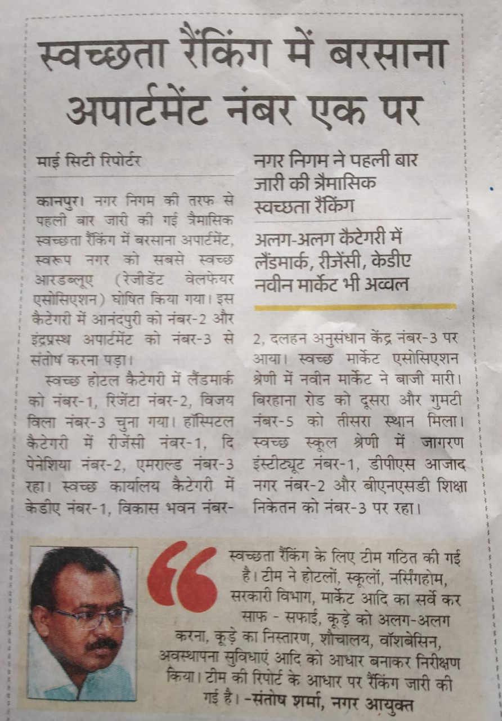

Slide 16
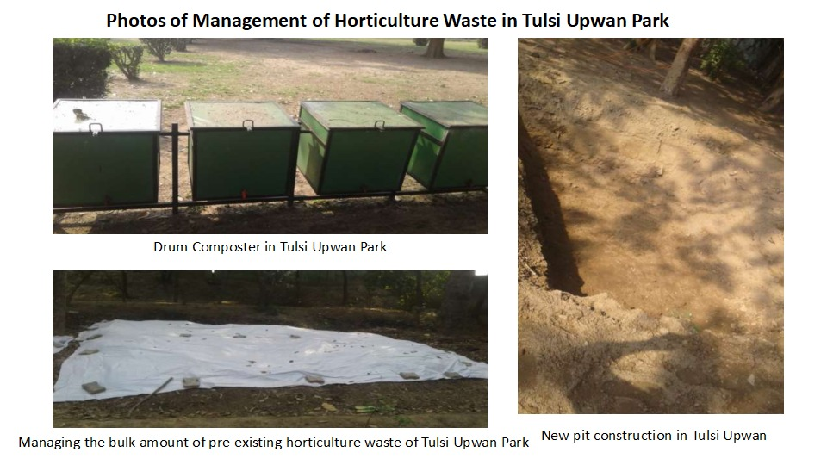

Slide 17
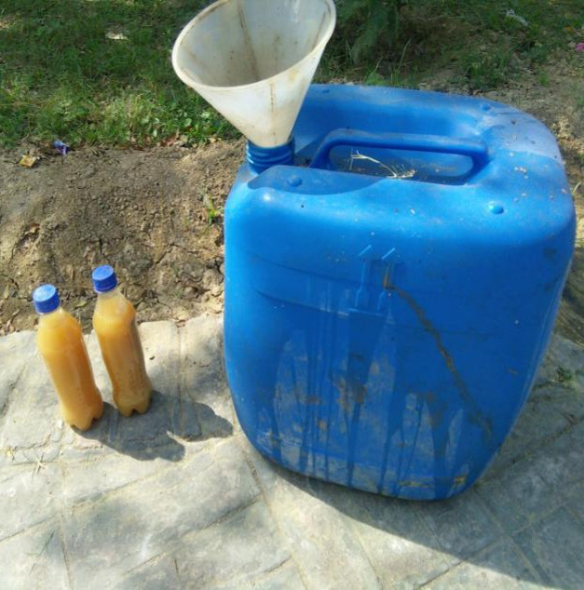
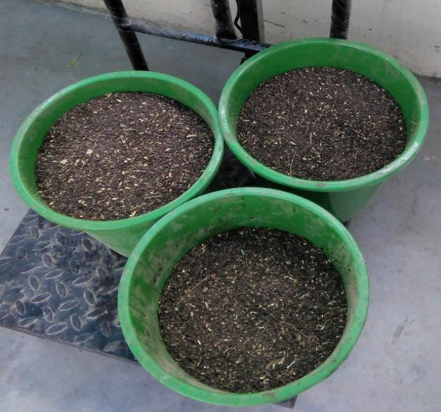
Pricing Model/Cost Benefit Analysis
Growing Paddy rice in 1 ha of land in one crop cycle (4 months)
According to GoI, avg. yield of Paddy rice is ~2.5 Tons/ha
Current rate of Paddy is INR 17.5/Kg
With increased yield and saving on fertilizers
~INR 9400/ha
Activity | Unit Price (Rs.) | Amount (Rs.)
10 Bags of Urea | 340/Bag | 3400
5 Bags of DAP | 1325/Bag | 6625
Total amount used on Chemical Fertilizers 10025
500 L of our Compost | 10/L | 5000
Total Savings 5025/ha
Likely Increase in Yield 5-10%

Slide 18
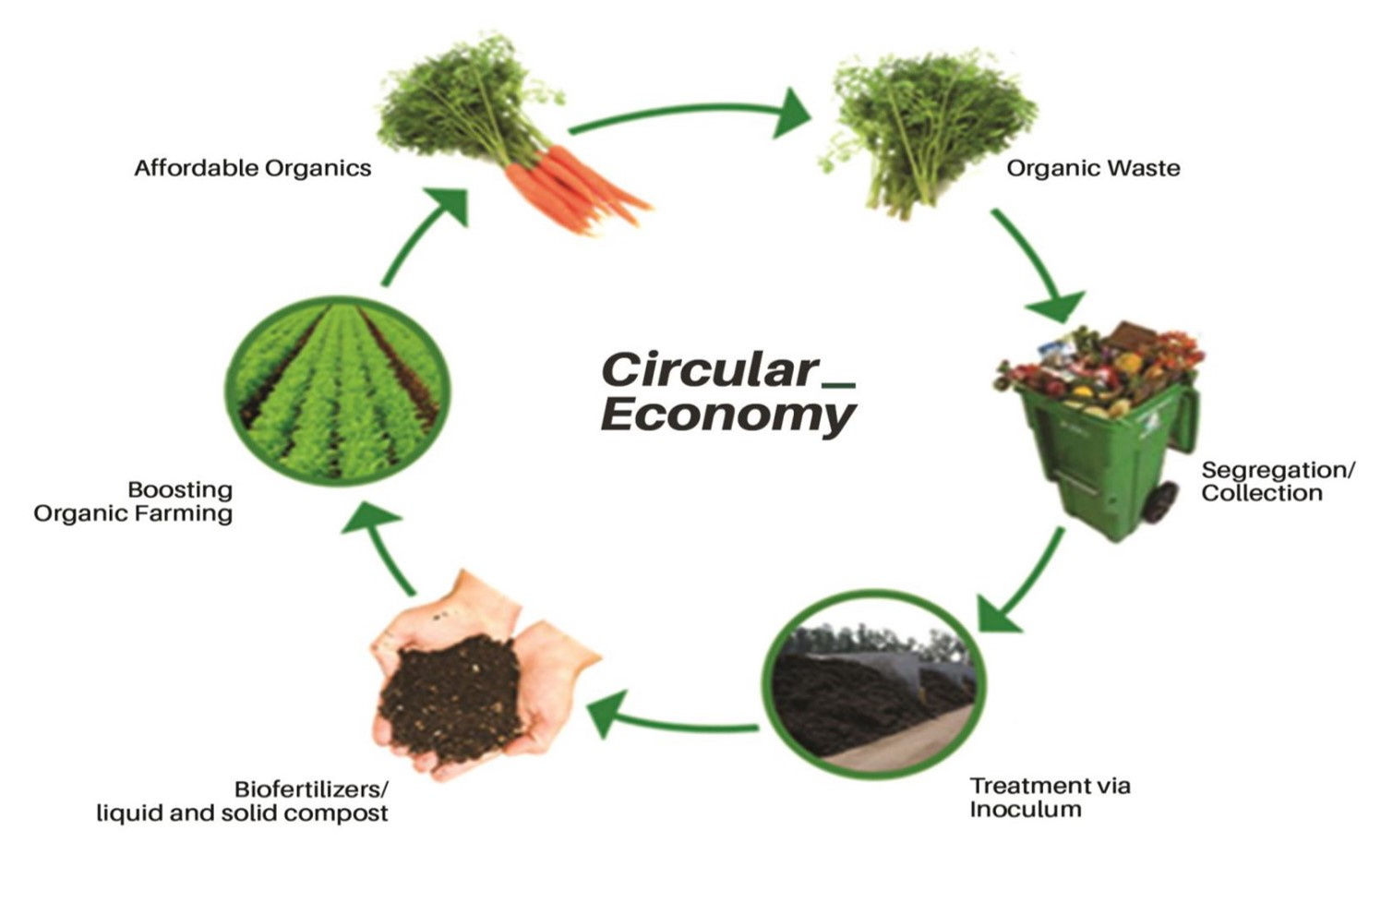

Slide 19
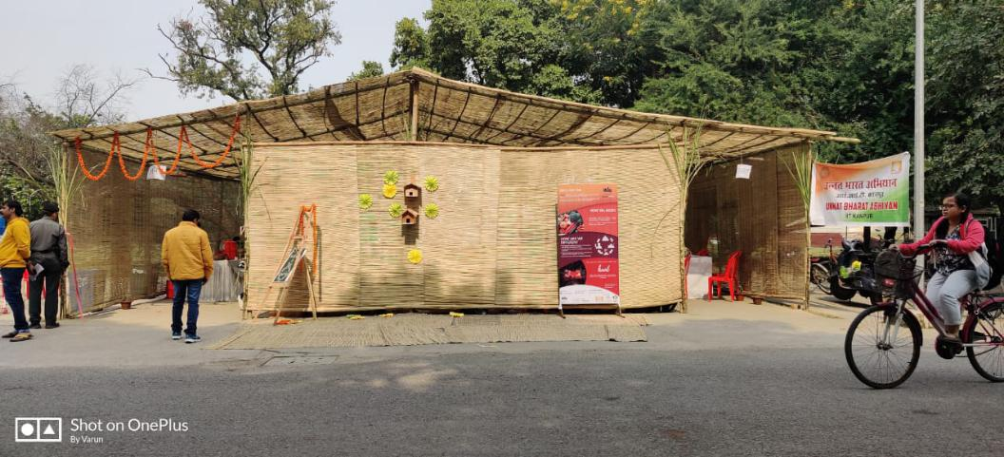
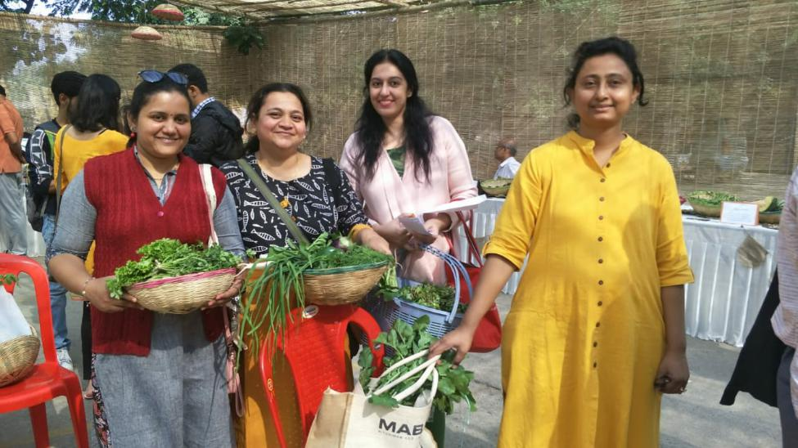
Pictures of Farmer's Haat
Plan is to establish Farmer's Haat in different cities.
This concept will help to establish a circular econmy around waste management and organic farming.

Slide 20
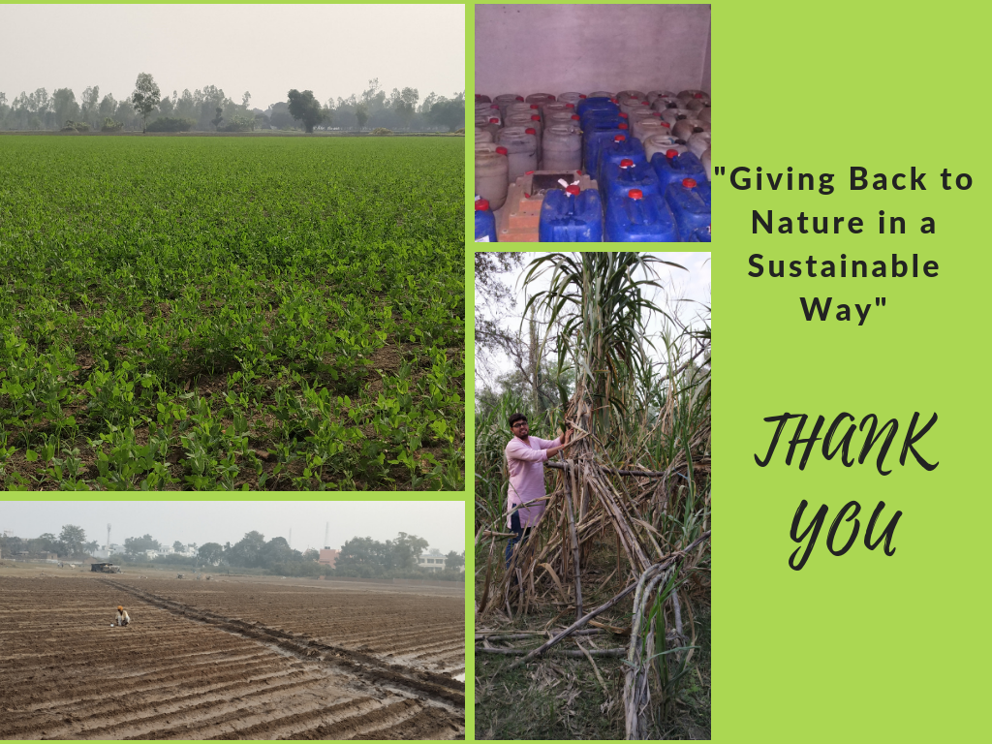
Liquid Compost packed for distribution in Pilibhit district
Pea Farm using our Compost Pilibhit district (U.P.)
Sugarcane farming using our Compost Pilibhit district (U.P.)
Liquid Compost used before sowing in Pilibhit district (U.P.)

