Slide 1
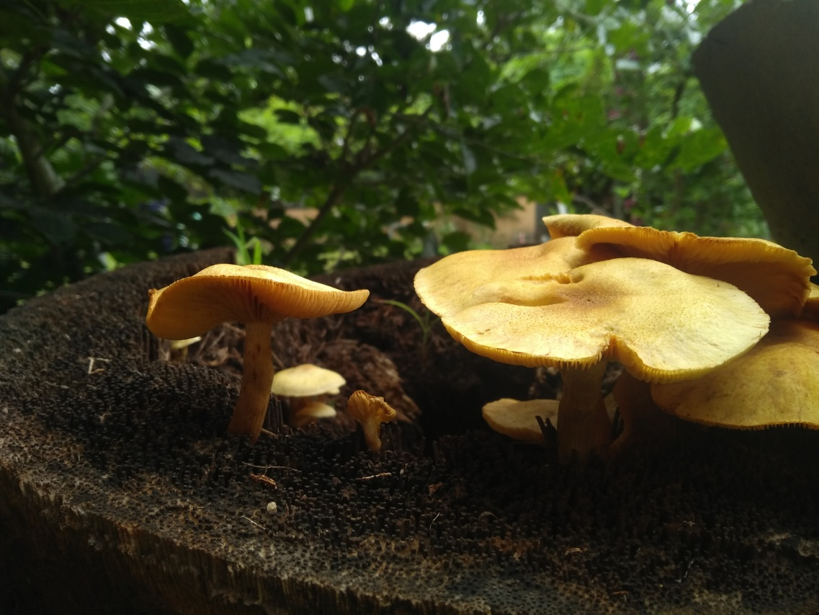
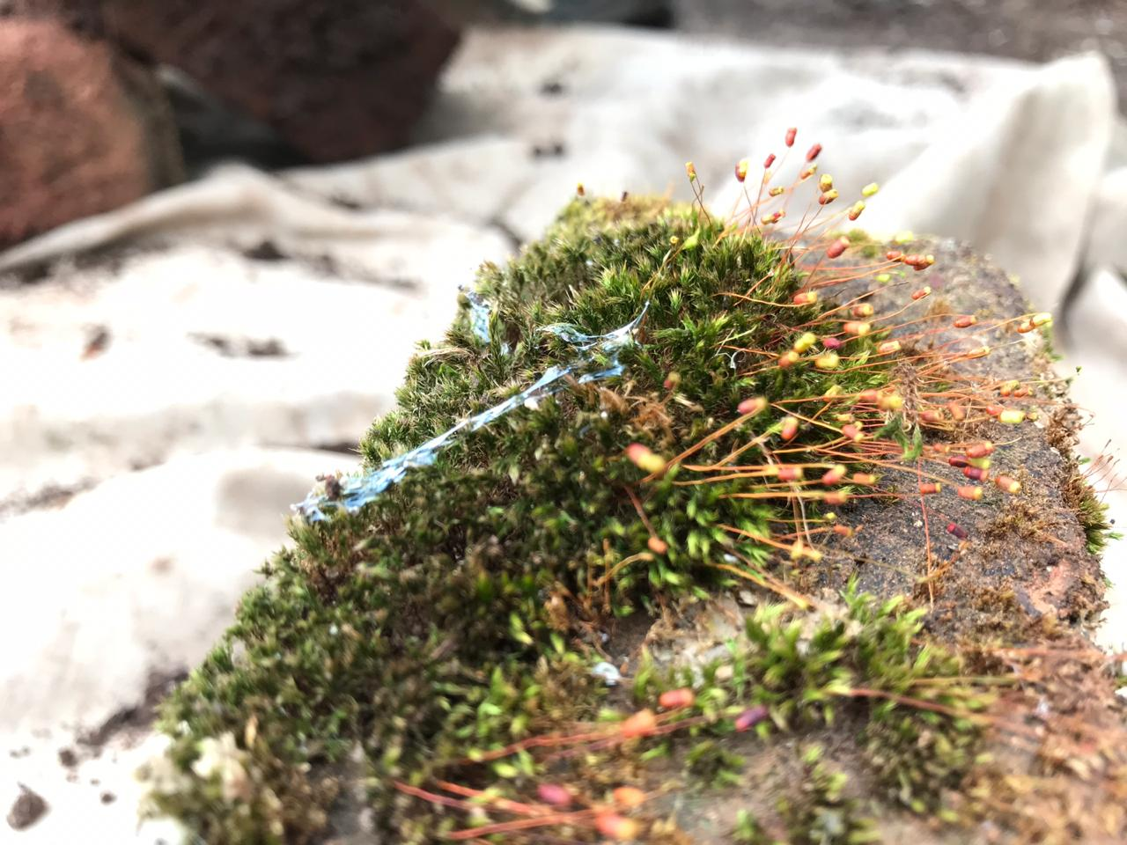
Nurturing Naturalists
An embodied, care-based account of generating pro-environmental motivations through urban farming
Deborah Dutta

Slide 2
An urgent need: Revise EE pedagogy to promote PEA
“While an environmental education curriculum should be interdisciplinary and focus on real practical problems, school curricula are discipline-based and emphasise abstract theoretical problems.
Whereas a curriculum in environmental education is emergent and problematic in that the content arises as students are involved in specific environmental problems,
most school curricula are predefined since they are designed to serve predetermined behaviourally specific ends (that is, ends whose attainment can be readily assessed).” (Stevenson, 2007, p. 147)
What is the way forward?
How can we nurture environmental sensitivity and the motivation to act in pro-environmental ways?

Slide 3
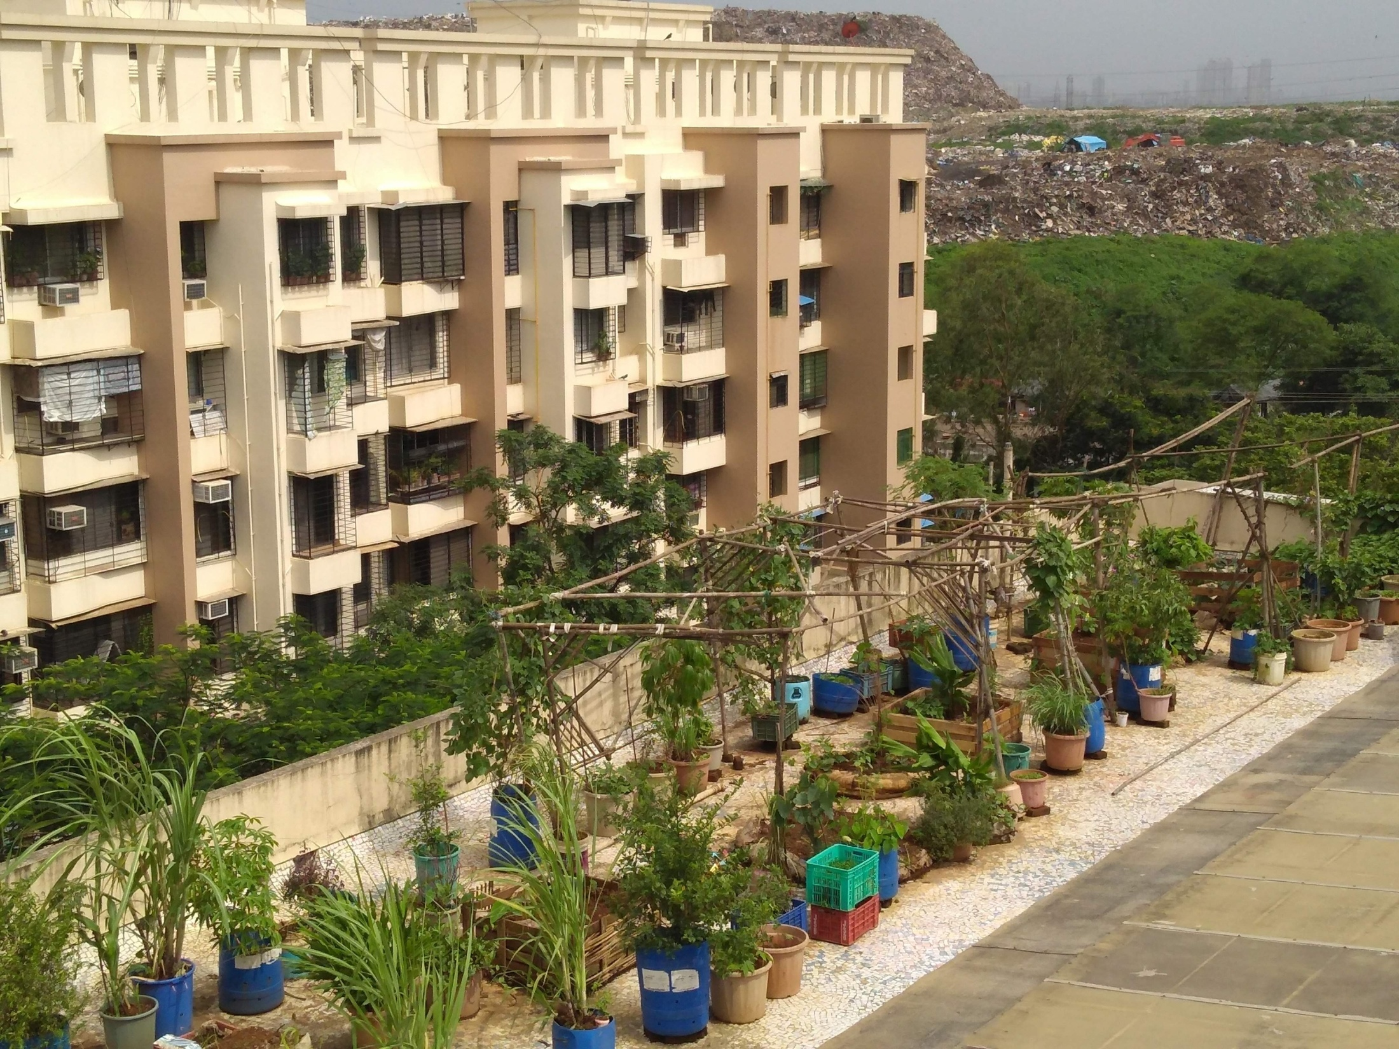

Slide 4
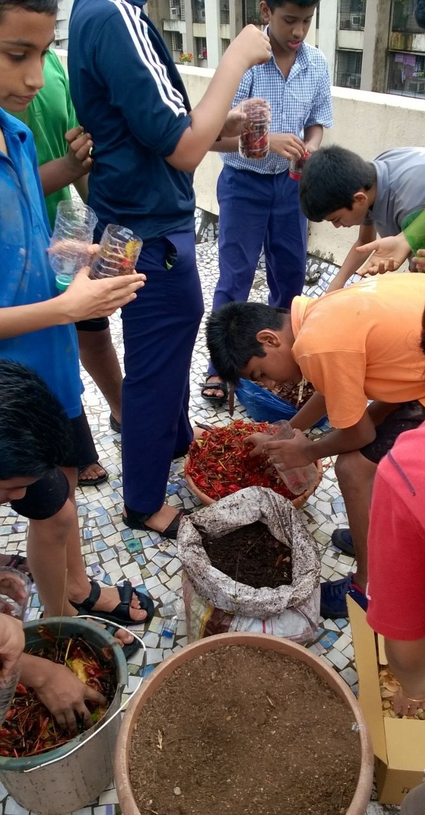
Description of the school terrace farm
Terrace space of a CBSE school in Mumbai, 40 VIII grade students, 10 months; 26 contact sessions
Ungraded project. Co-conducted with 2 expert facilitators, 2 teachers, and school gardeners.
Major activities:
making compost pit
collecting dry leaves
mulching the plants
making sapling and cardboard planters
designing and making bamboo trellises
plant care, saving seeds and harvesting
Data: Videos, questionnaires, in-depth interviews (14 students, 10 parents, 4 teachers), farm-logs, student diaries, photos

Slide 5
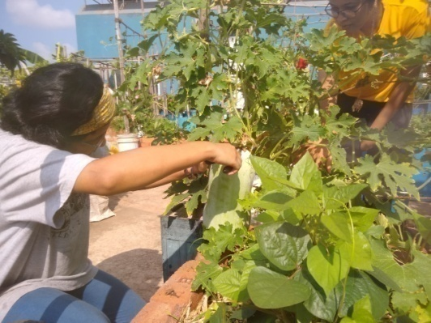
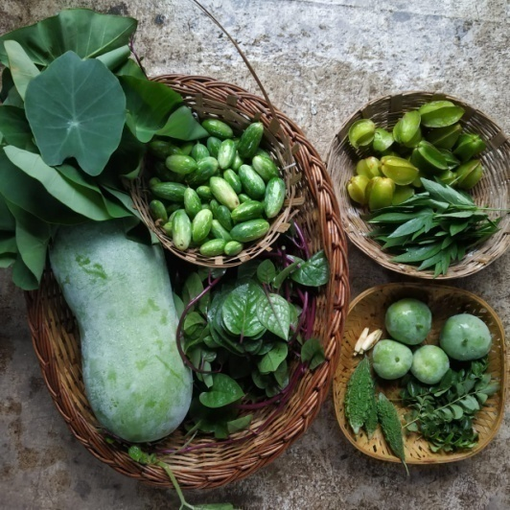
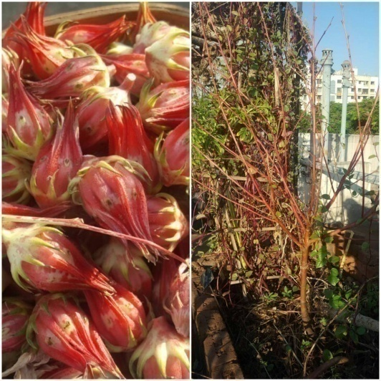
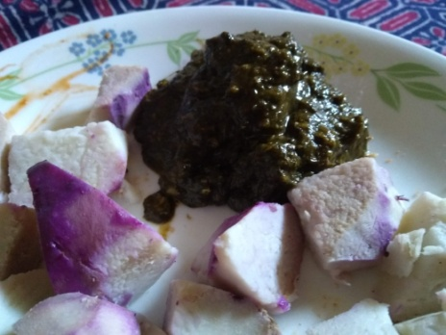
Practices and Key Elements
Health of plant
Local climate
Local Adaptation
Harvesting
Sharing recipes
Biodiversity
Notes:
Harvesting sunlight, space and water. Health of the plant, pollination, biodiversity, seed quality

Slide 6
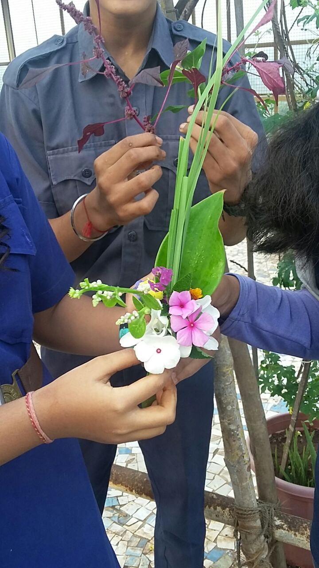
Somaesthetic* Interactions
“we never even touched plants this way earlier.. I mean we play on the grass, but not this way. To take care.. this time we learnt how to grow the plant, otherwise it is said that just drop a seed and the plant will grow... the book says that.”
Students’ engagement with plants were in a rich, visceral manner, through senses of touch, smell and taste, which widened their experience of the environment.
Students began identifying plants based on sensory interactions such as “waxy leaves”, “thick leaves”, “minty taste”, “sour taste”, “sharp leaves” and so on
*(Shusterman, 2003; Doddington, 2013)

Slide 7
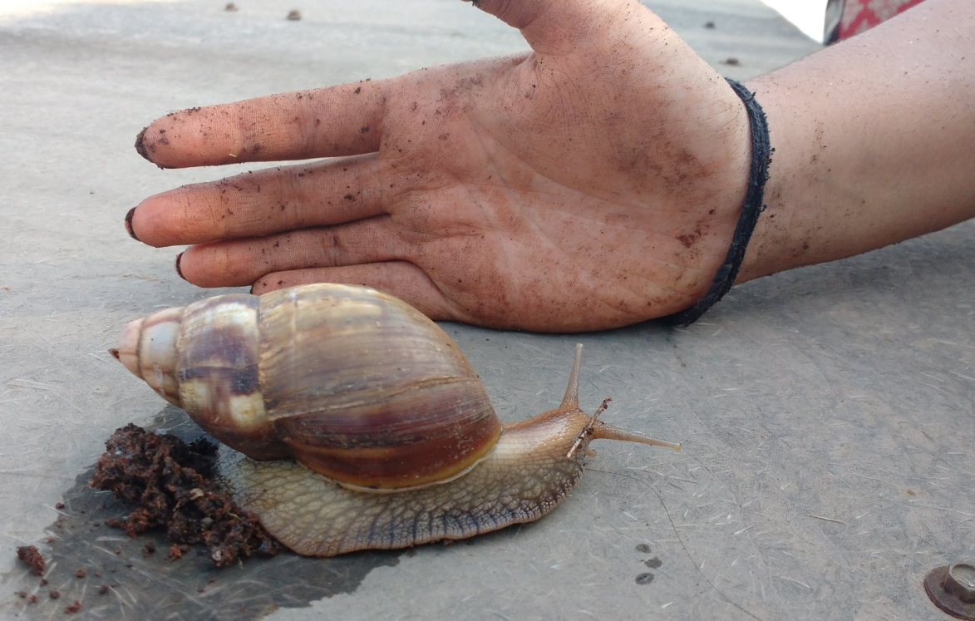
Instances of ‘enchantment’
Mundane observations turned into significant emotional experiences, because of the way everyday events were situated within the farming experience.
“We can give it (snail) some fresh leaves to eat too. We don't need to harvest everything!”
Bennett (2010) uses the term 'enchantment' to describe such affectual moments, and further argues such encounters to be critical in seeding empathy, and generosity towards the more-than-human world.

Slide 8
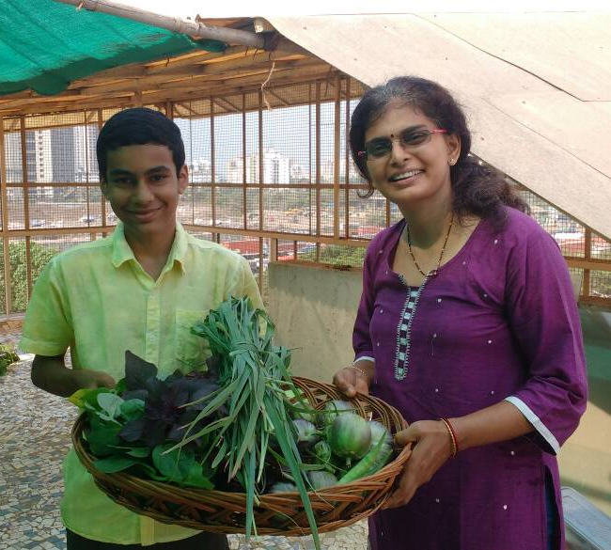
Theme III: Intergenerational influence
Parents were gradually drawn into the farming practices, moving from passive spectators to actively supporting their children’s interest.
Parent interviews validated student data about actions away from the farm site.
“He wants to be with plants all the time.. We already have few plants at home and now he is keen to shift them all to the new house. We are planning to make a small vertical ladder-type planters in our new home to support his passion...” (KNM)
“He has become keen on using wet waste to make manure. We save all greens, wastage in a bag for him. He also regularly waters the plants himself, and does that mulching he learnt in school...” (NMM)

Slide 9
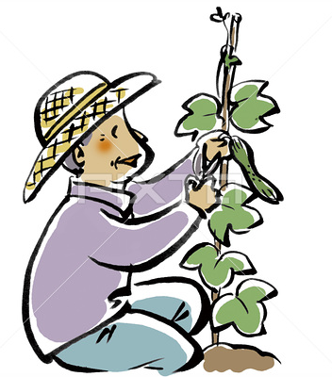
Theme III: Intergenerational influence
Children’s experience of farming activities affected adults in various ways.
Interestingly, children began looking up to their grandparents who already had rich, implicit knowledge about growing plants.
“Earlier when my grandmother used to mention it (gardening), it wasn’t a topic of much interest to me because I did not know anything about it. So I used to just avoid this topic. But now that I have seen so much happening and it is so exciting, so I have started to help my grandmother out. In fact, when I told her about all this (terrace farming), then she got hyped means totally hyped. On the same day, she did not tell me, she went to the nursery, bought a few saplings, seeds, pots, mud everything and she brought it home. Now, we are growing a lot of stuff.” (AN)

Slide 10
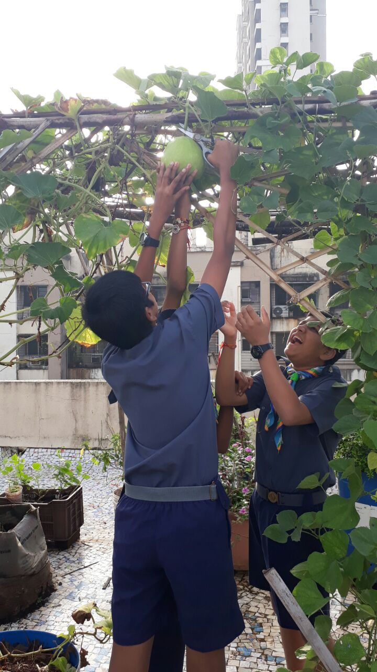
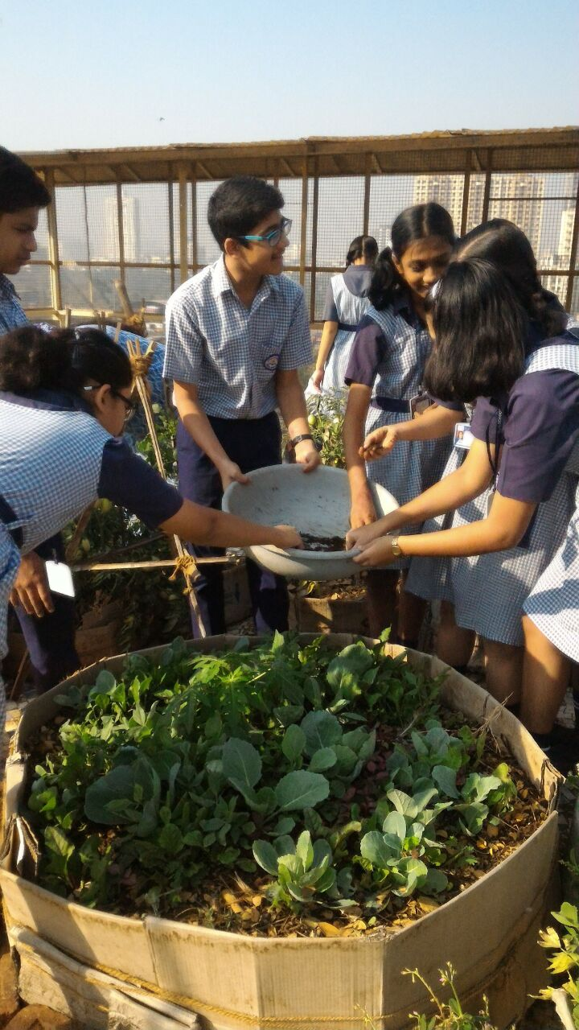

Slide 11
Generalising from the two findings
Self-reinforcing spiral generated by affective events
New community interactions based on affect and actions
Farm –based affective experiences
Strengthen
Nurture empathy driven manifestation of
Moments of ‘Enchantment’
Somaesthetic interactions
Directs attention, and leads to
Notes:
Put loop
11

Slide 12
Discussion
The ‘mattering’ of matter
Cognitive capacities are not just enacted, but created through interaction with physical entities in the environment. I extend this argument to include the evolution of values through material involvement.
b) Centrality of affect in generating an ‘ethic of care’
Building a meaningful relationship with the environment requires immersive, sensorium-based experiences, which generate the rich, moral imagination necessary to think and act in pro-environmental ways.

Slide 13
Selected References
Ajzen, I., & Fishbein, M. (1975). Belief, attitude, intention and behavior: An introduction to theory and research. Reading, MA: Addison- Wesley.
Alsop, S., & Watts, M. (2003). Science education and affect. International Journal of Science Education, 25(9), 1043–1047.
Altman, I., & Low, S. M. (2012). Place attachment (Vol. 12). Springer Science & Business Media.
Bai, H. (2015). Peace with the earth: animism and contemplative ways. Cultural Studies of Science Education, 10(1), 135–147.
Bandura, A., & Schunk, D. H. (1981). Cultivating competence, self-efficacy, and intrinsic interest through proximal self-motivation. Journal of personality and social psychology, 41(3), 586.
Barab, S., & Squire, K. (2004). Design-based research: Putting a stake in the ground. The journal of the learning sciences, 13(1), 1-14.
Barrett, M. J. (2006). Education for the environment: action competence, becoming, and story. Environmental Education Research, 12(3–4), 503–511.
Bennett, J. (2001). The enchantment of modern life: Attachments, crossings, and ethics. Princeton University Press.
Berry, W. (1992). The pleasures of eating. Cooking, eating, thinking: Transformative philosophies of food.
Bonnett, M. (2013). Sustainable development, environmental education, and the significance of being in place. Curriculum Journal, 24(2), 250–271. https://doi.org/10.1080/09585176.2013.792672
Bonnett, M. (2015). The powers that be: Environmental education and the transcendent. Policy Futures in Education, 1478210314566730.
Chandrasekharan, S., & Tovey, M. (2012). Sum, quorum, tether: Design principles underlying external representations that promote sustainability. Pragmatics & Cognition, 20(3), 447–482.
Chawla, L. (1998). Research methods to investigate significant life experiences: Review and recommendations. Environmental Education Research, 4(4), 383–397.
De Jaegher, H., & Di Paolo, E. (2007). Participatory sense-making. Phenomenology and the cognitive sciences, 6(4), 485-507.
De Jaegher, H., Di Paolo, E., & Gallagher, S. (2010). Can social interaction constitute social cognition?. Trends in cognitive sciences, 14(10), 441-447.
De Young, R. (2000). New ways to promote pro-environmental behavior: Expanding and evaluating motives for environmentally responsible behavior. Journal of Social Issues, 56(3), 509–526.
Deci, E. L., & Ryan, R. M. (2000). The" what" and" why" of goal pursuits: Human needs and the self-determination of behavior. Psychological Inquiry, 11(4), 227–268.
Hards, S. (2011). Social practice and the evolution of personal environmental values. Environmental Values, 20(1), 23–42.
Kaplan, S., & Kaplan, R. (2008). Health, supportive environments, and the reasonable person model. In Urban Ecology (pp. 557–565). Springer.
Krasny, M. E., Russ, A., Tidball, K. G., & Elmqvist, T. (2014). Civic ecology practices: Participatory approaches to generating and measuring ecosystem services in cities. Ecosystem Services, 7, 177–186.
Nersessian, N. J., Kurz-Milcke, E., Newstetter, W. C., & Davies, J. (2003). Research laboratories as evolving distributed cognitive systems. In Proceedings of the annual meeting of the Cognitive Science Society (Vol. 25, No. 25).
Noddings, N. (2013). Caring: A relational approach to ethics and moral education. Univ of California Press.

Slide 14
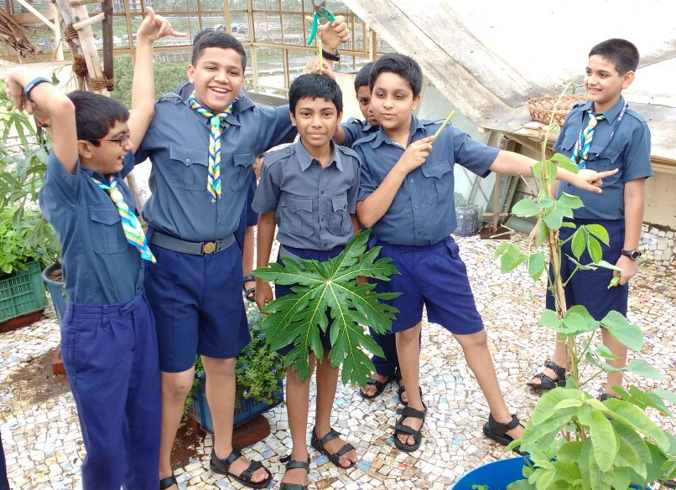
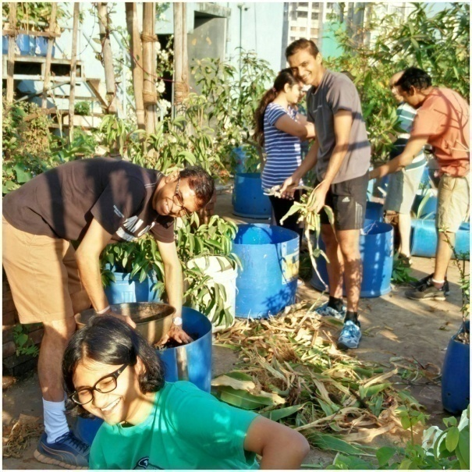
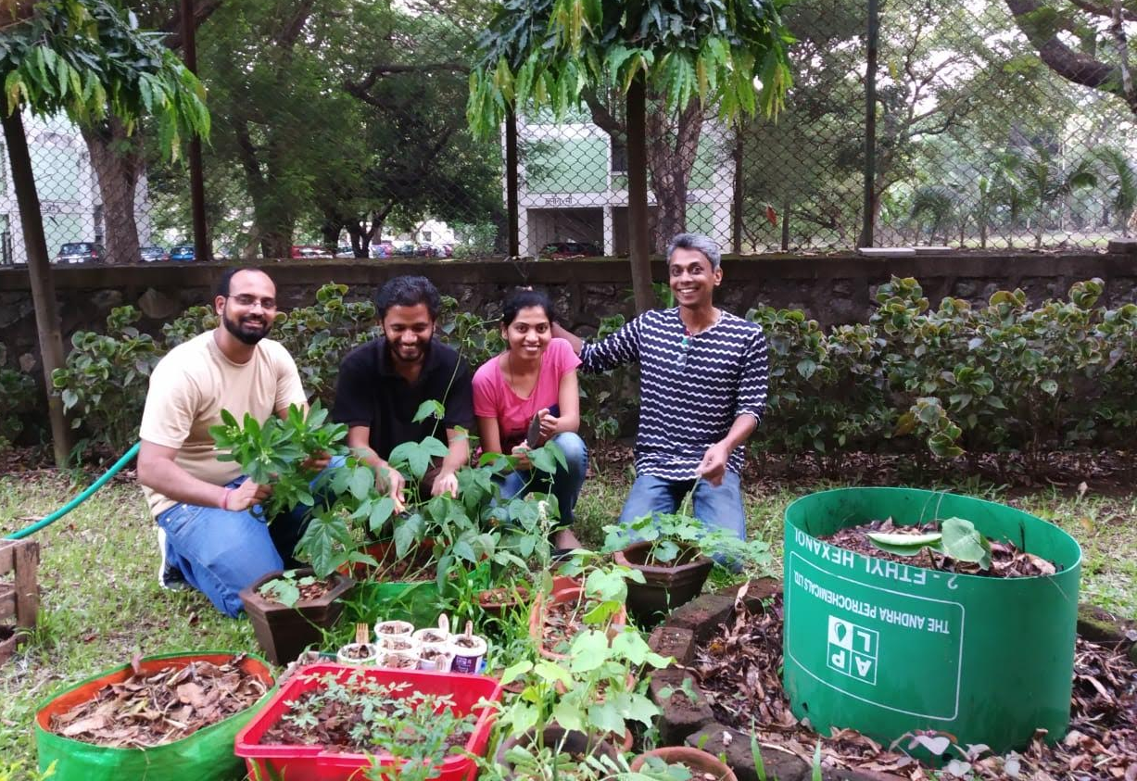
Acknowledgements and Credits
Sanjay Chandrasekharan, Ankush Gupta,
Siddharth Tiwari, Urban Leaves Volunteers Geetanjali Date, Adithi Muralidhar, Dev Dutta Dibyanshee Mishra, Mumbai School, Students GreenSouls Facilitators, Aswathy Raveendran Himanshu Srivastava, Shweta Naik, LSR Lab
Manoj Nair,Rosemary Varkey, Research Scholars,
G Nagarjuna, Dean, Director, Faculty @HBCSE Cosmetic and Gardening Staff @HBCSE,
Friends & Family
Thank You
Image credits:
Freepik.com
Storyofstuff.org
Liekeland.nl
Brainpickings.org
Wikicommons
UL group

Slide 15
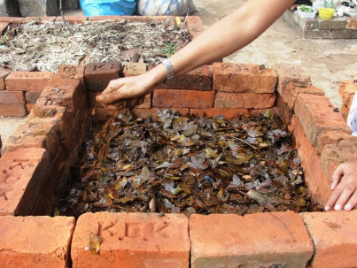
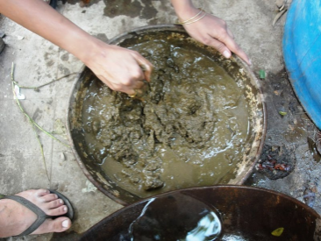
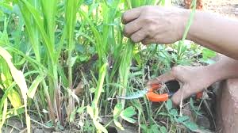
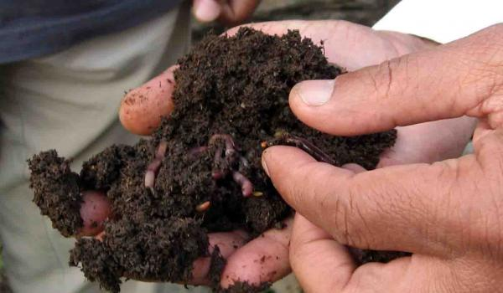
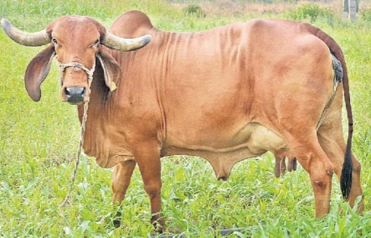
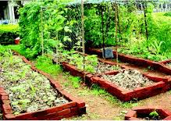
Practices and Key Elements
Carbon sequestration
Micro-organisms
Nitrogen fixation
Compost
Making
Amrut Mitti
Leguminous crops
Cow dung slurry
Soil biodiversity
Health of livestock
Plant biodiversity
Critters and earthworms
Cattle
Mixed crops
15

